Slide 1



State Properties Commission
Real Property Portfolio Management
Mission:
To advise, guide and maximize Georgia’s real estate portfolio by applying industry best practices in asset, space and transaction management
LEASING  SPACE PLANNING/DESIGN  ASSET MANAGEMENT  LAND ACQUISTIONS & DISPOSITIONS

Slide 2
State Properties Commission
Real Property Portfolio Management
Agenda
Welcome
Land Division
  REACH is now active- J. Wade
Leasing Division
  SPC/Brokers
    Agency Assignment Overview
    Break-Out Sessions with Agencies and Assigned Brokers
Q & A

Slide 3


Real Estate & Asset Communication Hub
Agency Training

Slide 4

For questions or additional information, contact
J. Wade – Phone: (404) 463-6161 – Email: j.wade@spc.ga.gov
Ryan Remle – Phone: (404) 232-1255 – Email: ryan.remle@spc.ga.gov
Clark Wong – Phone: (404) 656-2360 – Email: clark.wong@spc.ga.gov

Slide 5



Introduction
REACH – Real Estate and Asset Communication Hub
REACH is a web-based system that allows for electronic submission of agency real property requests, document sharing and status tracking.

Slide 6
Purpose
The system is designed to:
be more efficient than current process
eliminate the use of paper forms
provide real time access to the status of any transaction request
show each agency its individual dashboard quick reference to and tracking of requests

Slide 7
Access to REACH
Each Agency Land Coordinator must have a REACH user account. An account is created by completing and submitting the SPC Agency Agreement-Request for Access form located on the SPC Website http://gspc.georgia.gov//forms under REACH.
Upon receipt of the login and password, the Agency Land Coordinator can access REACH by logging into QuickBase http://georgiabuildingauthority.quickbase.com.

Slide 8
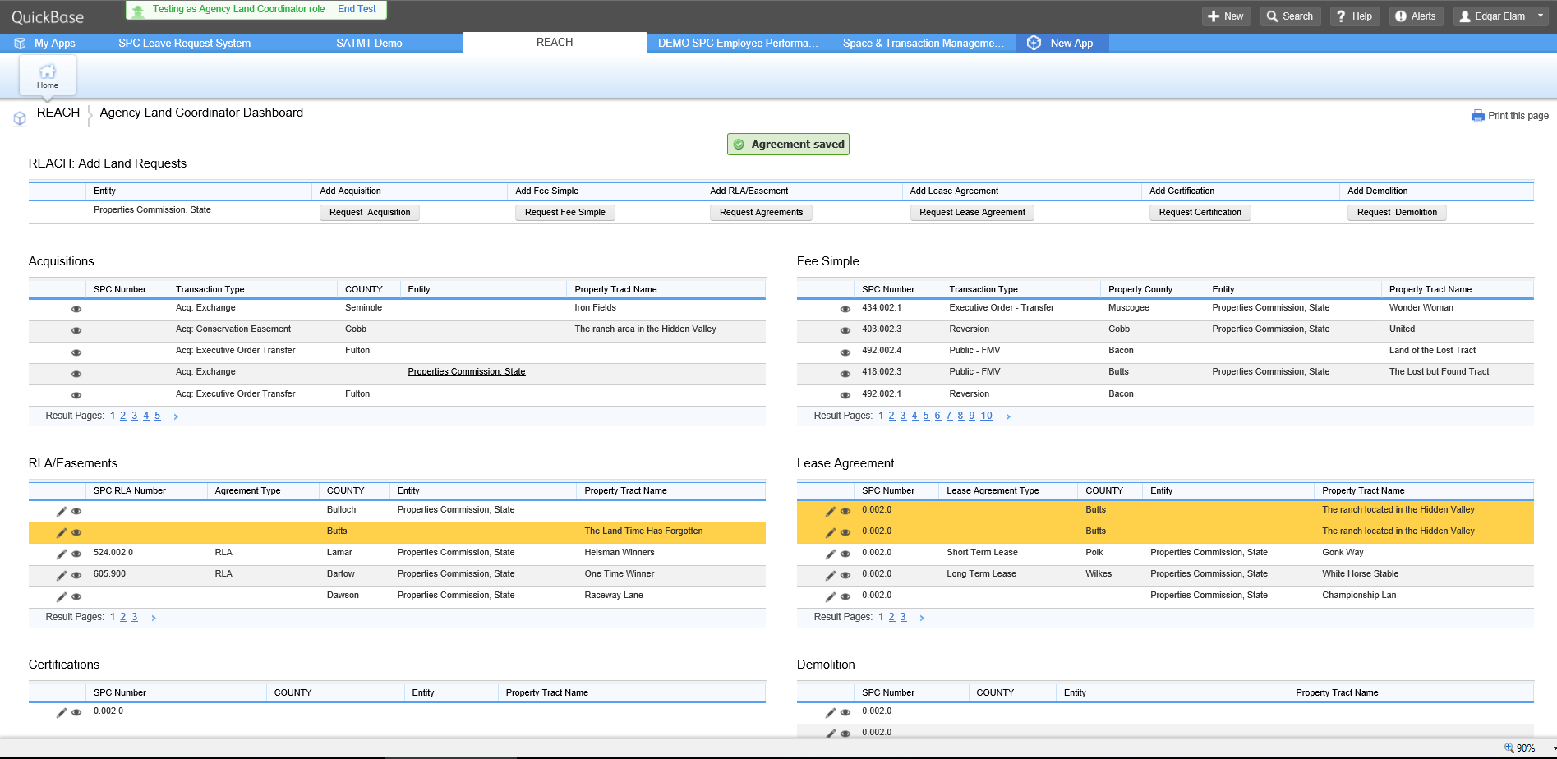


Transaction Requests

Slide 9
Transaction Types
Acquisition Tab: Select this tab for Acquisitions of a Conservation Easement, Condemnation, Donation, Easement, Encroachment Agreement, Exchange, Executive Order Transfer (acquiring agency), Purchase, & Other.
Fee Simple Tab: Select this tab for Surplus, Exchange, and Executive Order Transfer (disposing agency).
RLA/Easement Tab: Select this tab for Revocable License Agreement (RLA), RLA to Easement, and Easement.
Lease Tab: Select this tab for Short-term Lease, and Long-term Lease.
Certification Tab: Select this tab for Certification of Ownership
Demolition Tab: Select this tab for Executive Order for demolition.

Slide 10
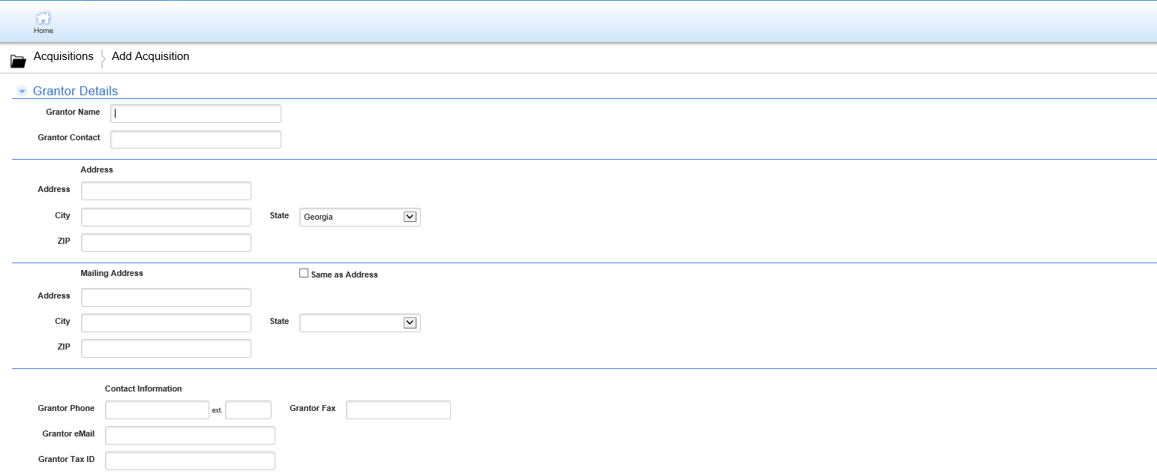

Acquisition – Grantor Detail

Slide 11
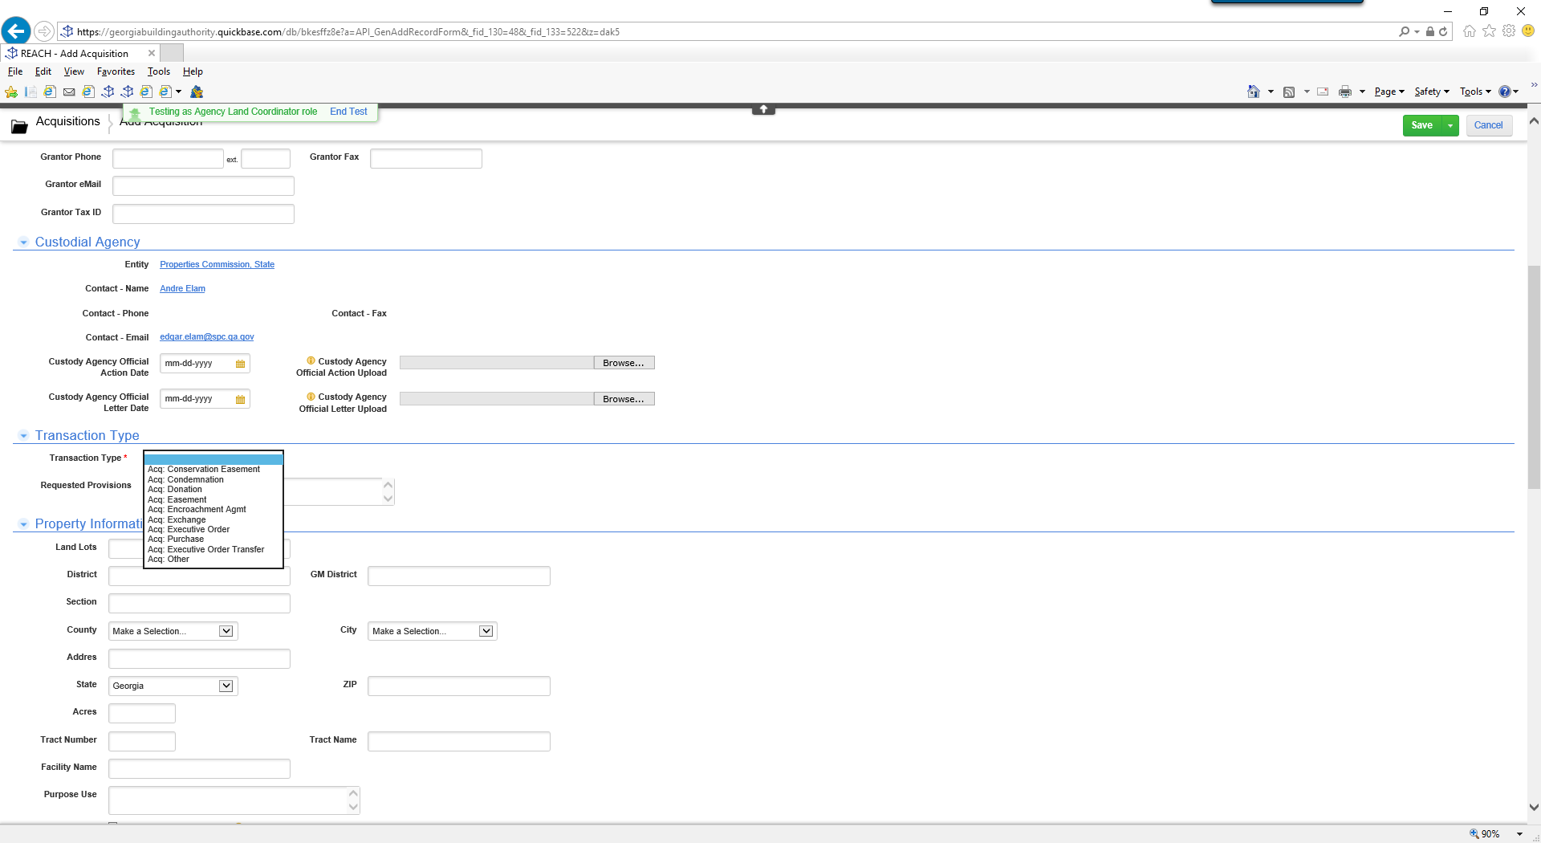

Acquisition

Slide 12
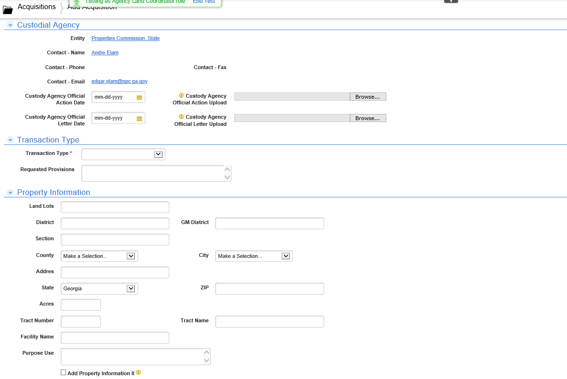

Acquisition- Property Information

Slide 13
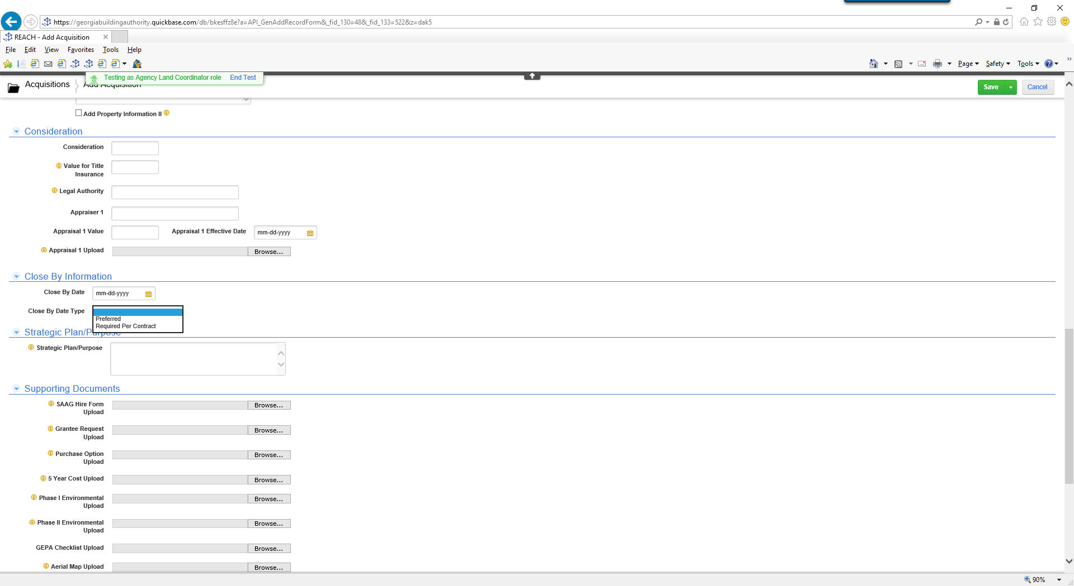

Acquisition – Consideration / Closing

Slide 14
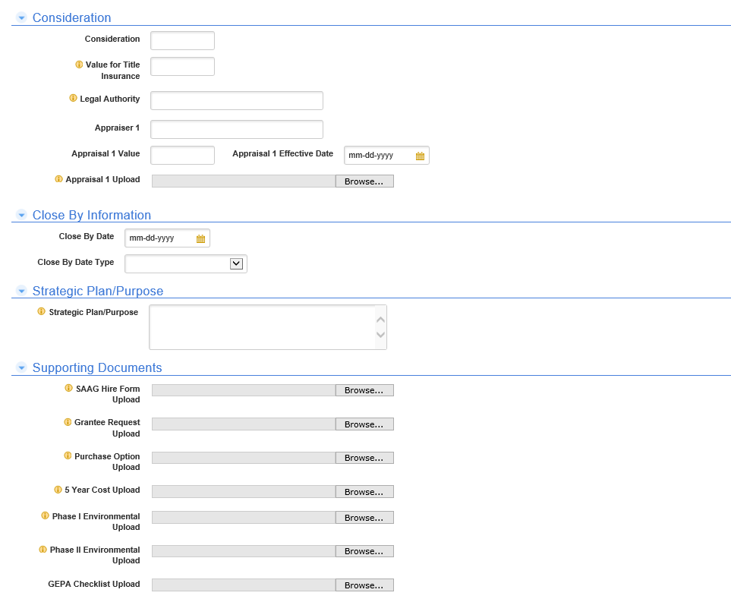
Acquisition- Upload Documents

Slide 15
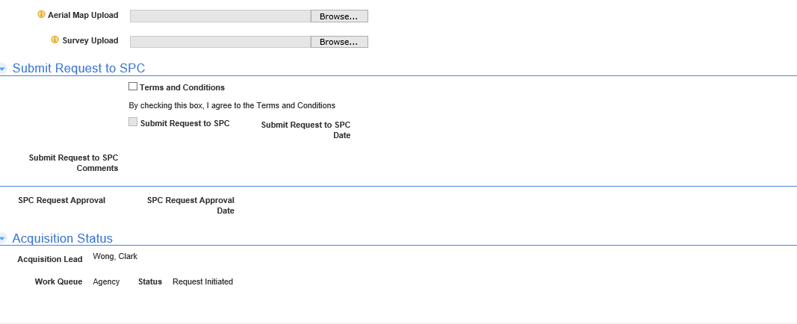

Acquisition- Submit to SPC

Slide 16
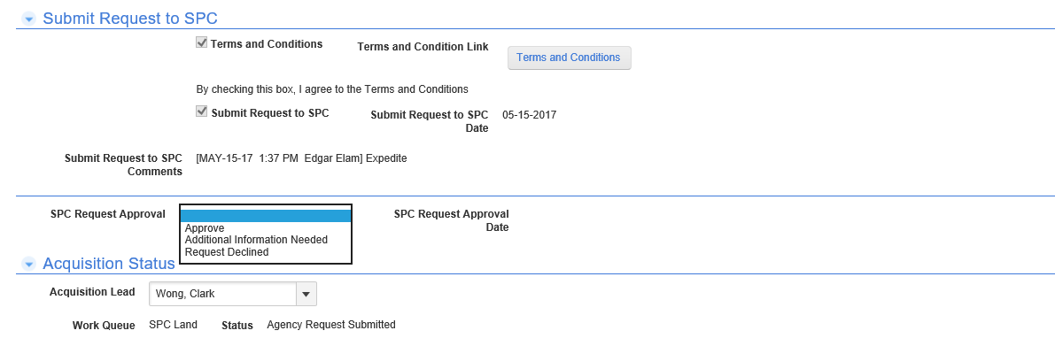
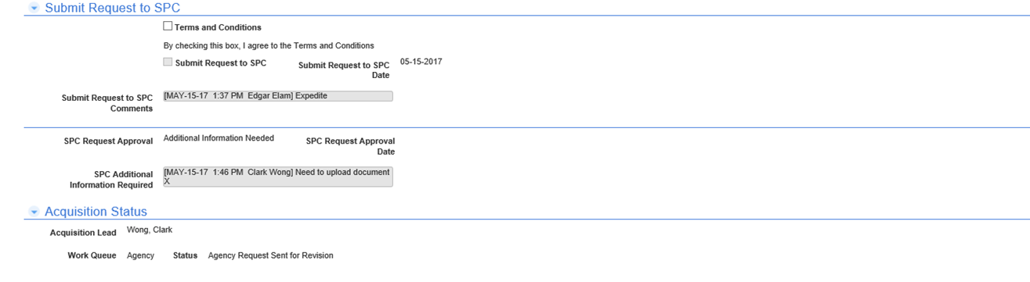

Acquisition- Status

Slide 17
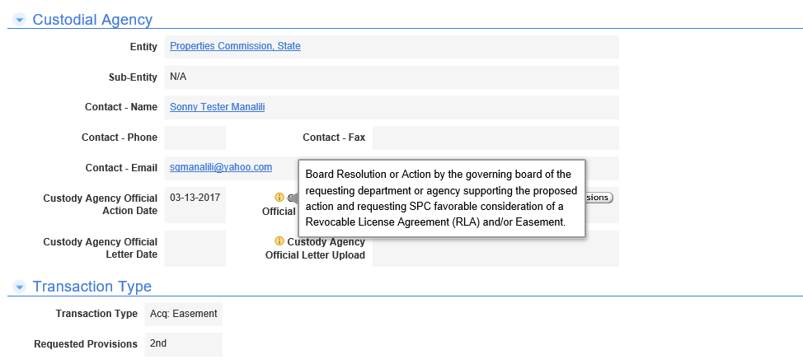
Features- Information Icons

Slide 18
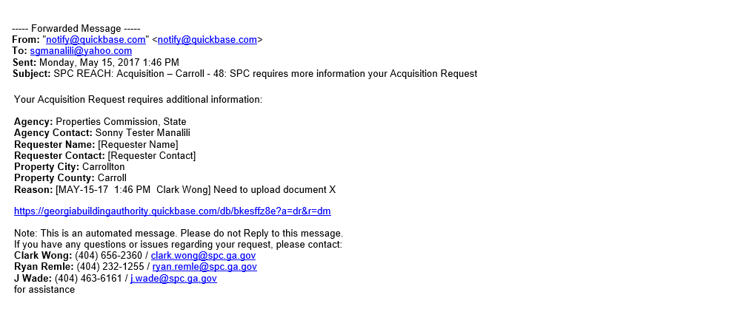

Features- Email Notifications

Slide 19
RLA/Easements

Slide 20
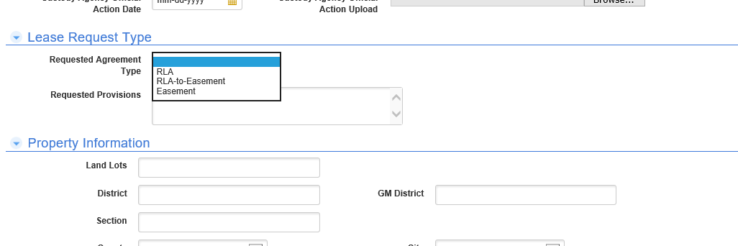
RLA & Easement – Request Type

Slide 21
Leases

Slide 22
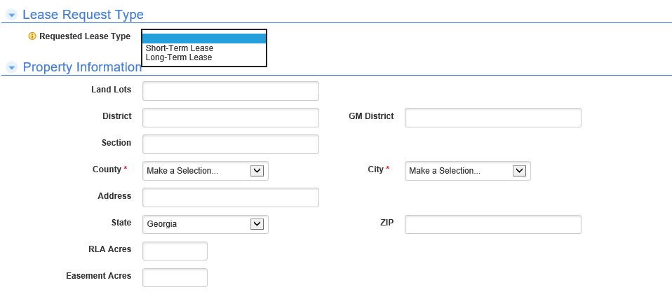
Lease Agreement – Lease Type

Slide 23
Fee Simple

Slide 24
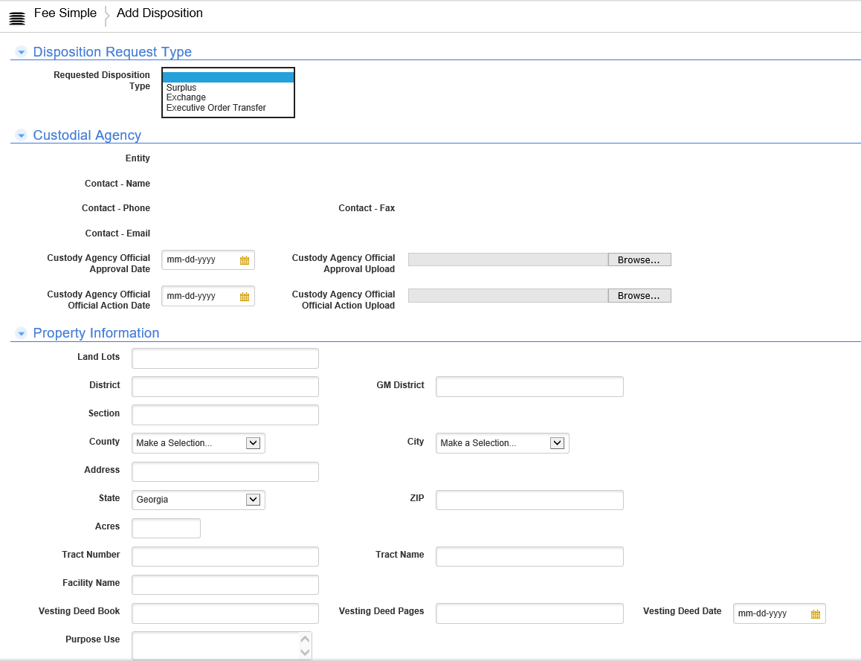
Fee Simple (Disposition) – Disposition Type

Slide 25
Demolition

Slide 26
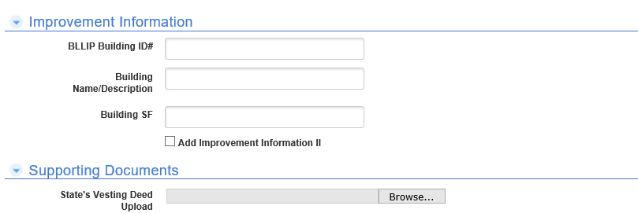
Executive Order Demolition

Slide 27
Certification

Slide 28
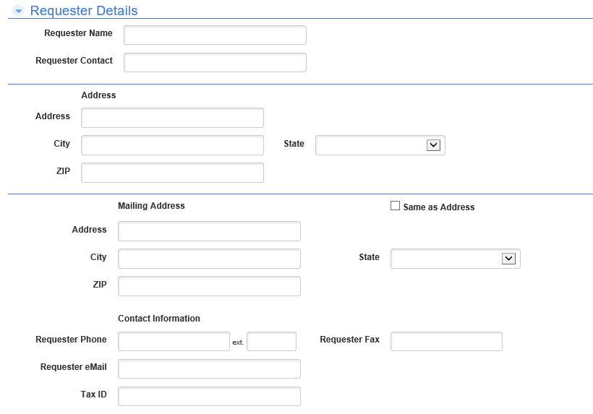
Certification of Ownership

Slide 29
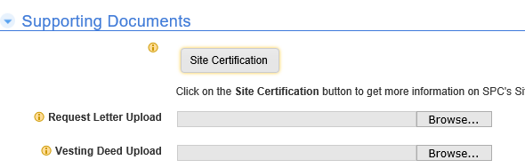
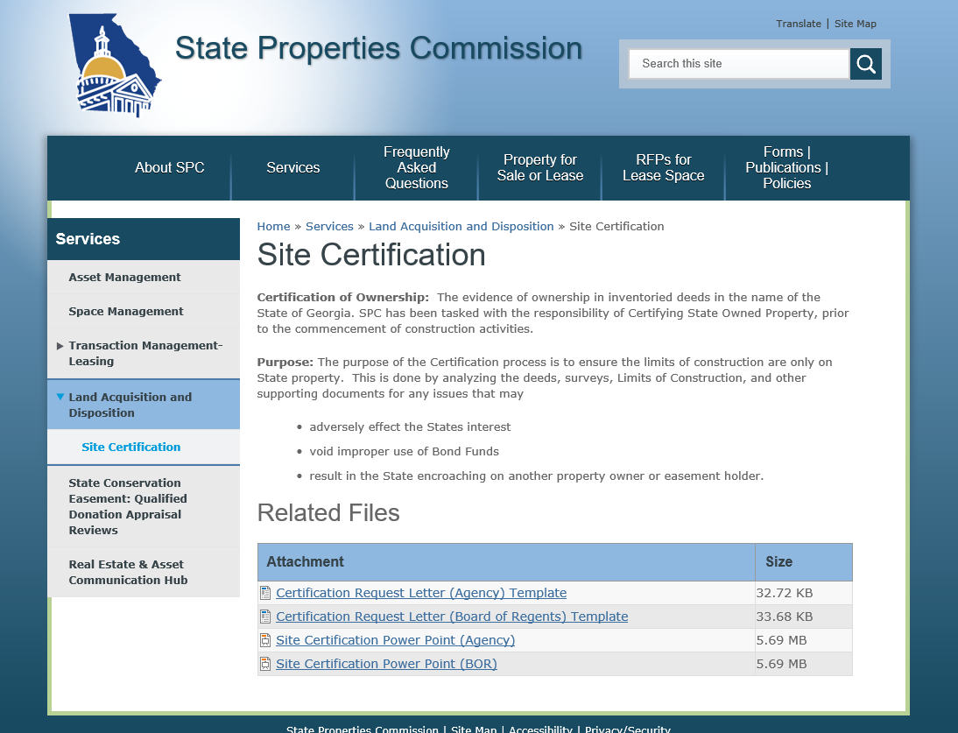
Certification of Ownership

Slide 30
?

Slide 31
State Properties Commission
Real Property Portfolio Management
Transaction Management - Leasing
RFP Selection Committee Responsibilities – Tamika Crittenden

Slide 32
RFP Selection Committee
RFP Selection Committee Members (Voting)
  Up to 2 members from SPC – 50%
  Up to 2 members from each Occupying Agency – 50%
RFP Selection Committee Advisors (Non-Voting)
  Assigned Contract Broker – Cresa or Savills Studley
  Project Manager and /or Architectural Partner
    Houser Walker Architecture
    Idea-Span

Slide 33
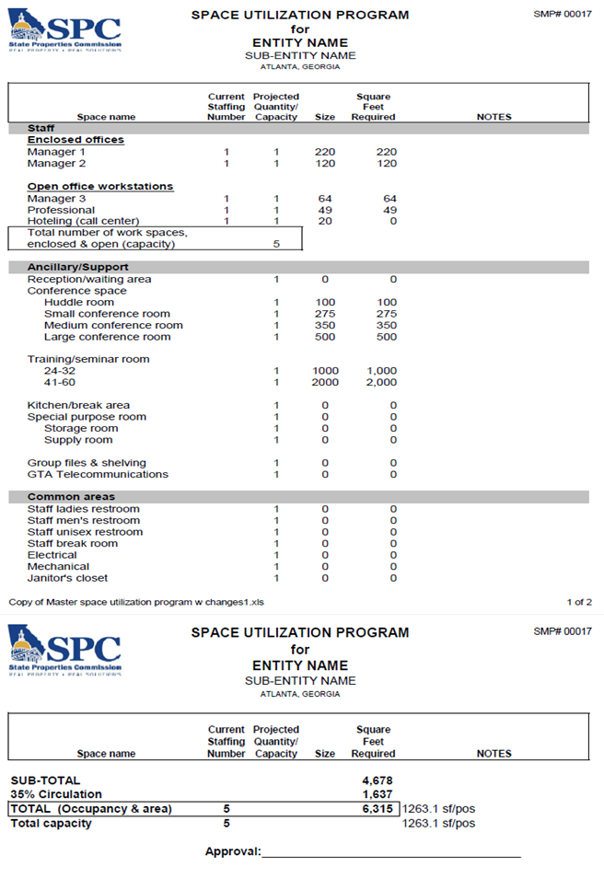
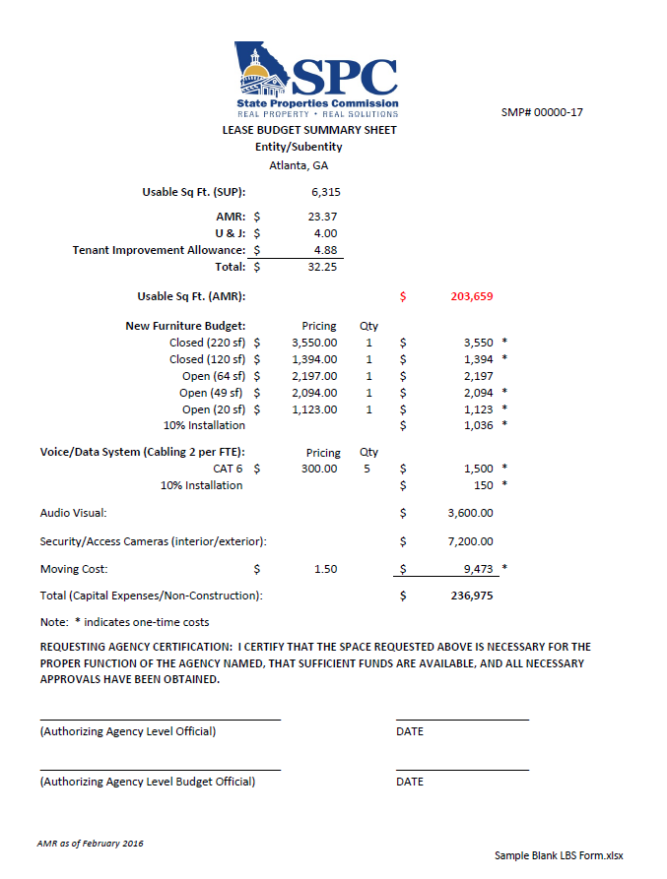
RFP Selection Committee Responsibilities
Review SUP
Review LBS

Slide 34

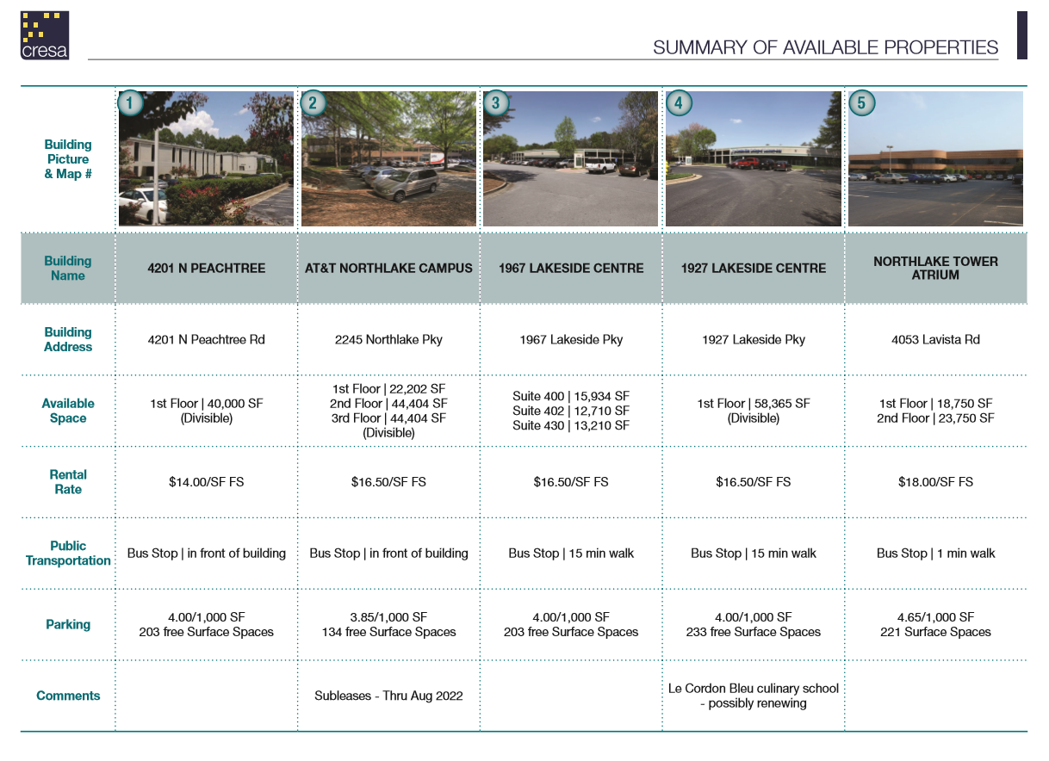
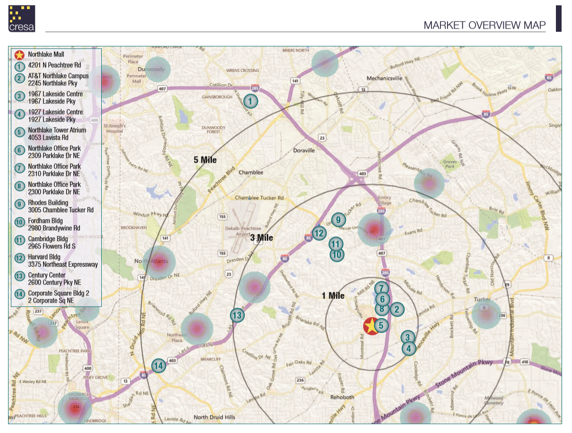
RFP Selection Committee Responsibilities

Slide 35
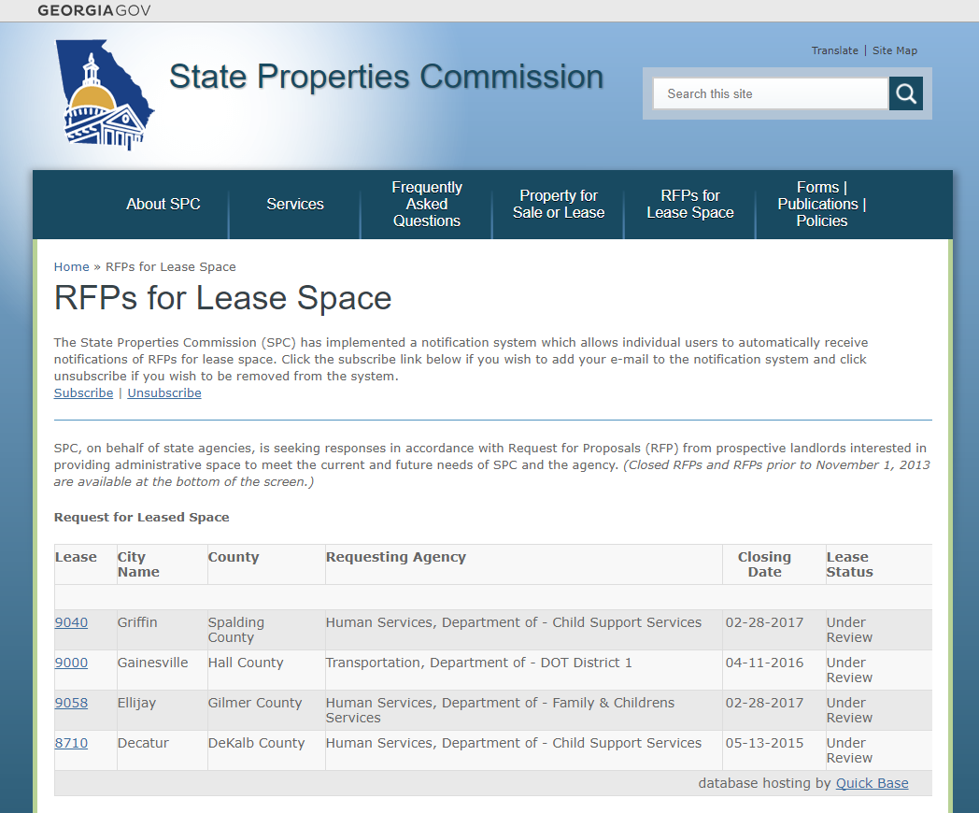
RFP Notifications on SPC Website

Slide 36
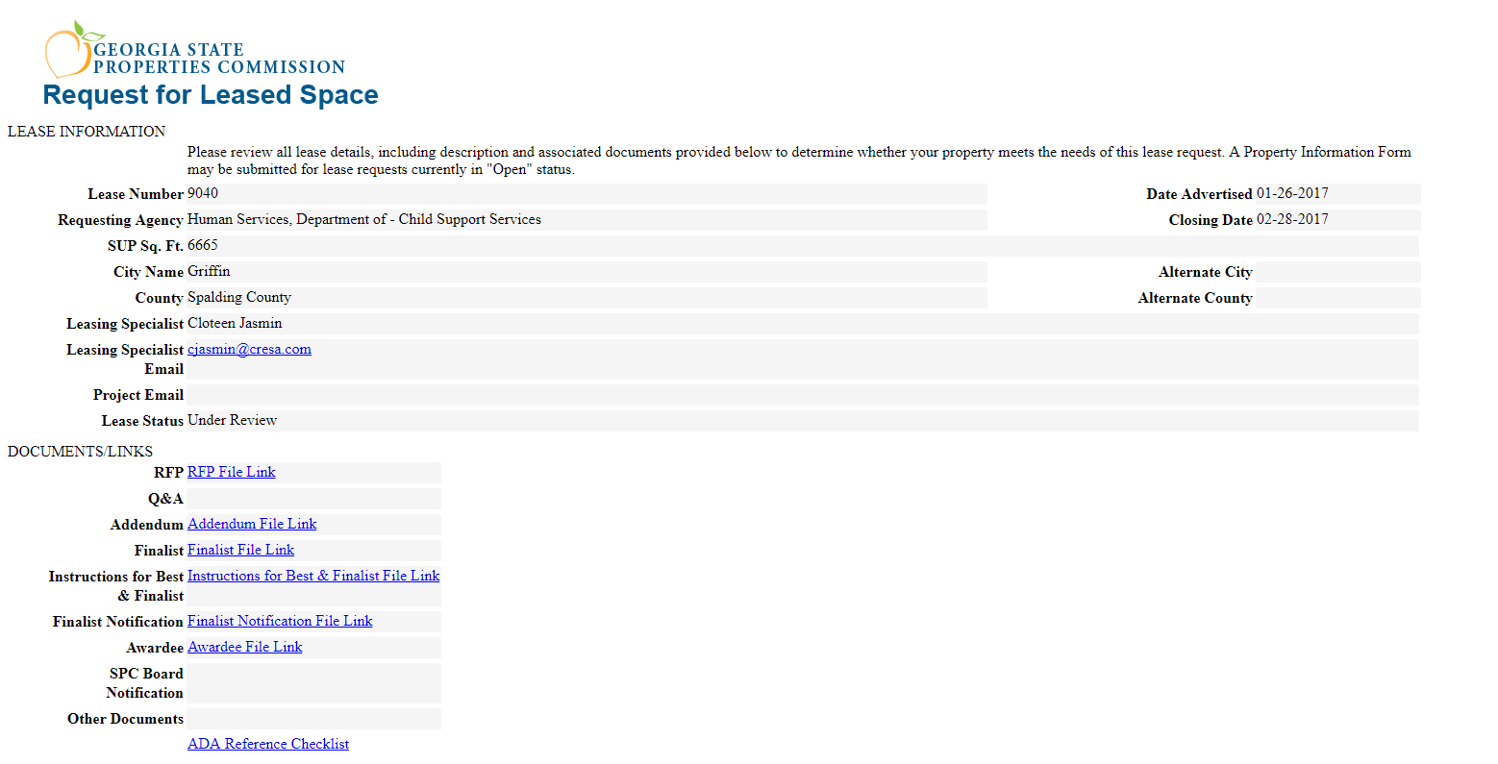
RFP Notifications on SPC Website

Slide 37
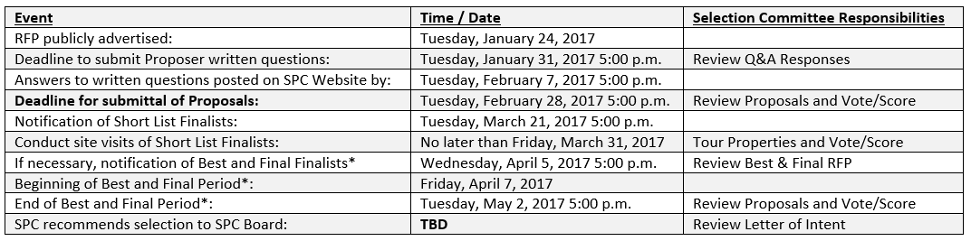
RFP Selection Committee Responsibilities
*SPC, at its discretion, may determine that the use of a Best and Final Bid Process is necessary for the selection of a bidder to be recommended to the SPC Board.

Slide 38
State Properties Commission
Real Property Portfolio Management
Transaction Management - Leasing
Agency Assignment Overview
Break-Out Sessions with Agencies and Assigned Brokers

Slide 39
Contact Information
State Properties Commission
Real Property Portfolio Management
Frank Smith- Deputy Executive Director
Office: (404) 656-5602
Alisa Pereira- Assistant Director
Office: (404) 463-5861
J. Wade- Land Acquisition & Disposition Manager
Office: (404) 463-6161
Tamika Crittenden- Leasing Section Manager
Office: (404) 463-5570
Andre’ Elam- Business Analyst
Office: (404) 463-6443
Note: A copy of this REMAT Presentation can be obtained at http://gspc.georgia.gov/publications

