Slide 1

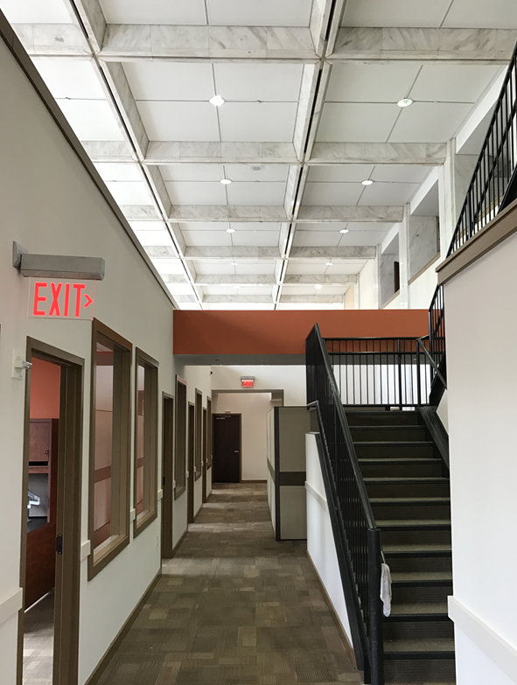

LEASING COORDINATOR MEETING
FEBRUARY 6, 2019

Slide 2

State Properties Commission
Real Property Portfolio Management
LANDLORD ISSUES
Document, Document, Document
  Without proper documentation, SPC is prevented from employing the Article V, Section 8, referred to as the “Self-Help” clause in the SPC Master Lease
    Agency vs. SPC Lease
Agency’s should develop a process with their local offices to convey issues with the Landlord.
  Single POC
  Special Forms
  Web-based tracking system
Plan should be in accordance to Agency/Landlord policies and standard protocol
Copy SPC on correspondence when necessary
  SPC should be notified/copied on major Landlord issues.

Slide 3
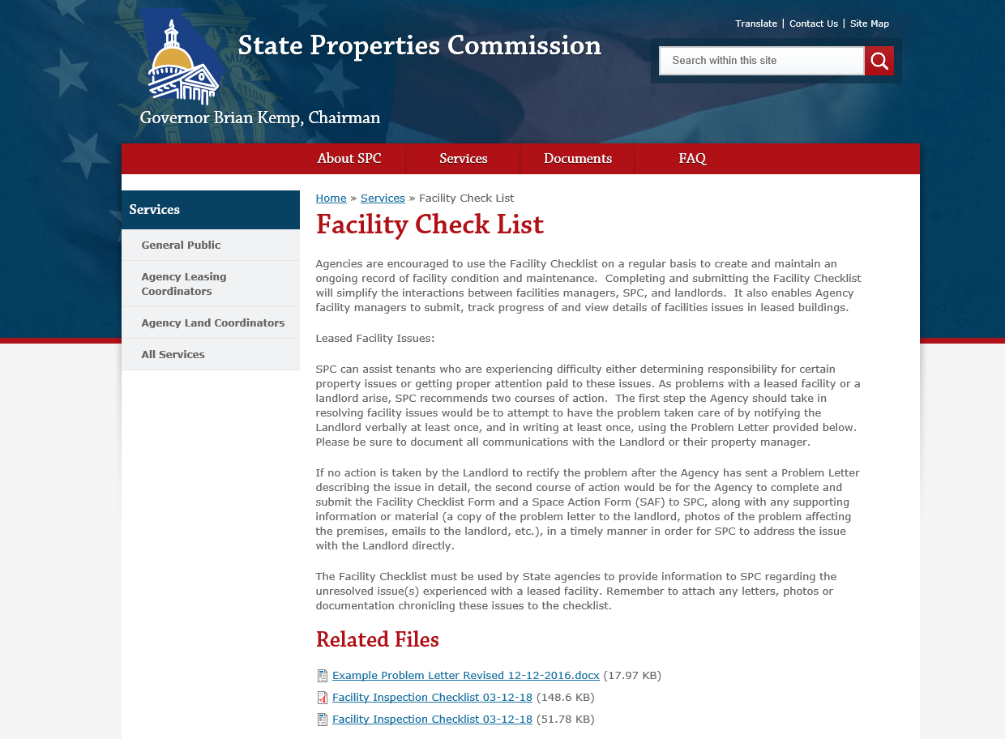
State Properties Commission
Real Property Portfolio Management
FACILITY CHECK LIST
https://gspc.georgia.gov/facility-check-list

Slide 4

EXAMPLE-PROBLEM LETTER

Slide 5
TENANT SELF-HELP
Article V, Paragraph 18 (Template Document):
  Non-Emergency Maintenance:
    Tenant may give Landlord written notice of maintenance needed that is Landlord’s responsibility
    If Landlord fails to commence such maintenance within 10 days of written notice and Tenant gives Landlord further written notice and nothing is done in 3 days
    THEN Tenant may proceed to undertake such maintenance
  Emergency Maintenance:
    Tenant may give Landlord written notice of maintenance needed that is Landlord’s responsibility
    If Landlord fails to commence such maintenance within 10 days of written notice
    THEN Tenant may proceed to undertake such maintenance
  Covering Cost:
    Invoice Landlord
      To be paid within 10 days of receipt of invoice
      Interest of 8%, per annum, from date of payment of Tenant
      If no payment with in 10 days, THEN right to deduct from rent

Slide 6
TENANT SELF-HELP
No general right to “Repair and Deduct”
NOTICE-Written Notice as defined in the Lease (Article V, Paragraph 4)
  Not simply an email or phone call
  Notice under the Agreement shall be in writing
    delivered by hand
    sent by registered or certified mail, postage prepaid, return receipt requested or
    sent by nationally recognized commercial courier for next business day delivery
    to the address in the Agreement, or to such other addresses as are specified by written notice
  Time Period Runs from
    Hand delivery-date delivered
    Mailed-date of deposit in the Mail

Slide 7

TENANT SELF-HELP
Example: Ahh!- My A/C’s on the fritz!
  -Call the Landlord/Property Manager; document with confirmation email copying both the Landlord and the Property Manager
  -If there’s a history of non-responsive Landlord
    Send a Letter (see example/template spc.ga.gov)
      Date of Lease Agreement
      State Problem-Emergency/Non-Emergency
      Reference Landlord responsibility
      Reference the Self-Help section
  Major Issue?-Let SPC know immediately

Slide 8
FACILITY INSPECTION CHECKLIST
General Information
Download from SPC website
Should be completed by agency on a regular basis to document property conditions. Agency to keep completed checklist in their records.
Submit form to SPC along with SAF ONLY if the documented items need be addressed by SPC

Slide 9


FACILITY INSPECTION CHECKLIST
PROACTIVE PROPERTY MAINTENANCE
Conduct routine inspections
  Address issues before they become a crisis
  Reduce repair costs & vendor maintenance contracts
  Shorten response/repair time
Fosters a positive Landlord/Tenant relationship
  Preserve the value of the real estate asset for the Landlord
  Maintain occupants’ safety and well-being

Slide 10
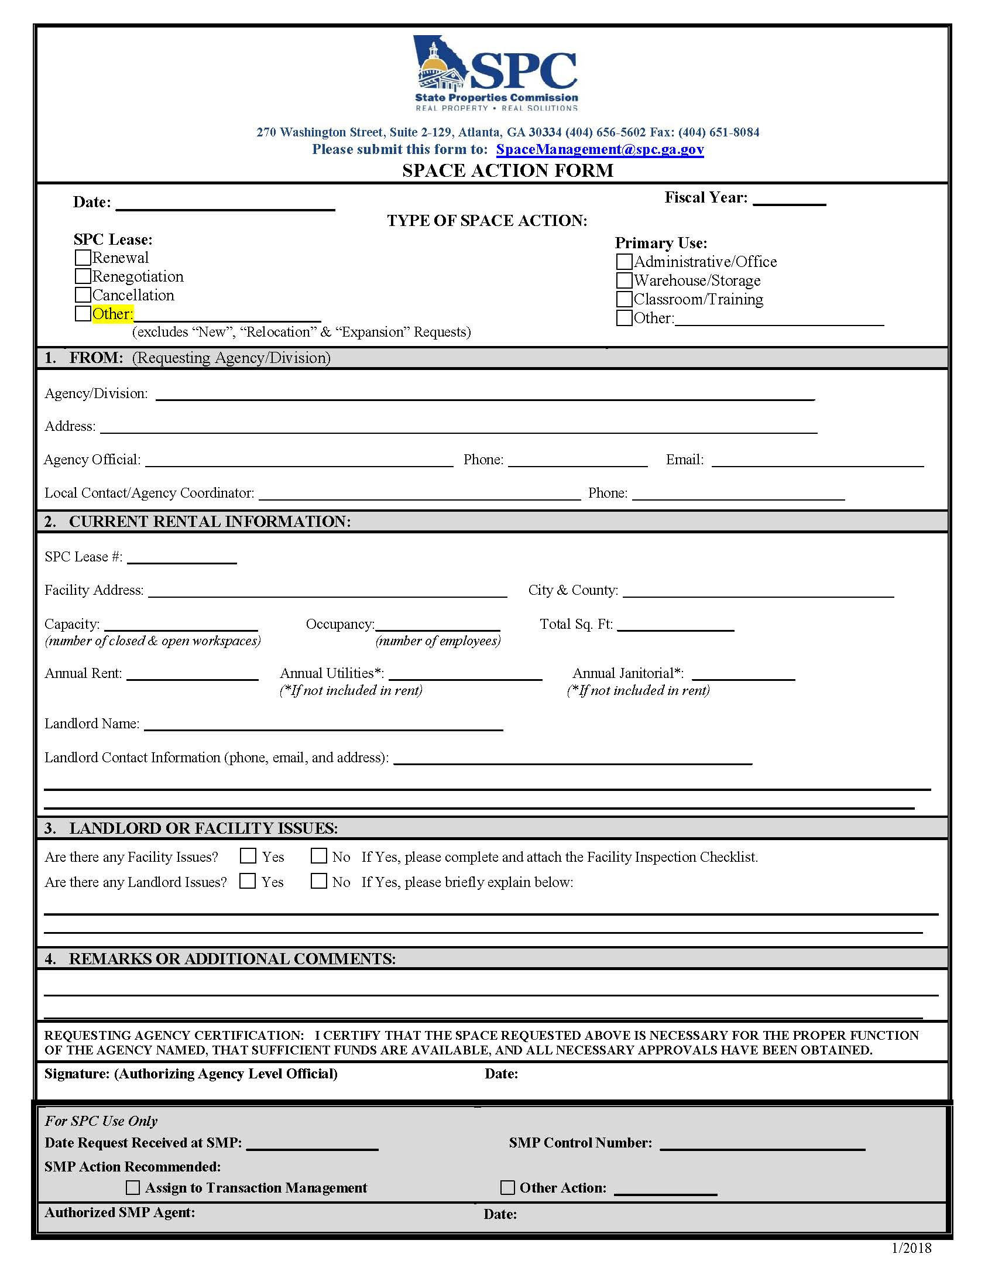
SPACE ACTION FORM
No changes to the Space Action Form (SAF).
Please mark “Other” on the form when submitting requests other than renewal, renegotiation and cancellation.

Slide 11
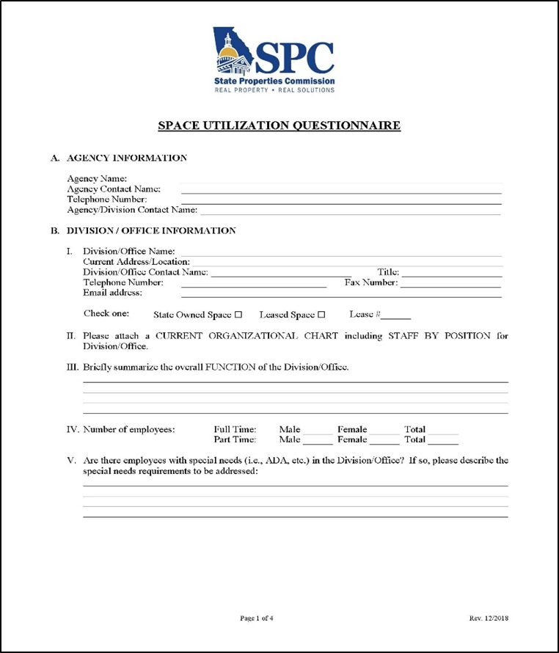
REVISIONS TO SPACE UTILIZATION QUESTIONNAIRE
The SUQ (consisting of 4 pages) should be submitted every time there’s a request for new, relocation, expansion/contraction of space.
Space Standards were recently revised to remove standard conference room types and sizes. Therefore, it’s important to note a few changes to the SUQ.

Slide 12
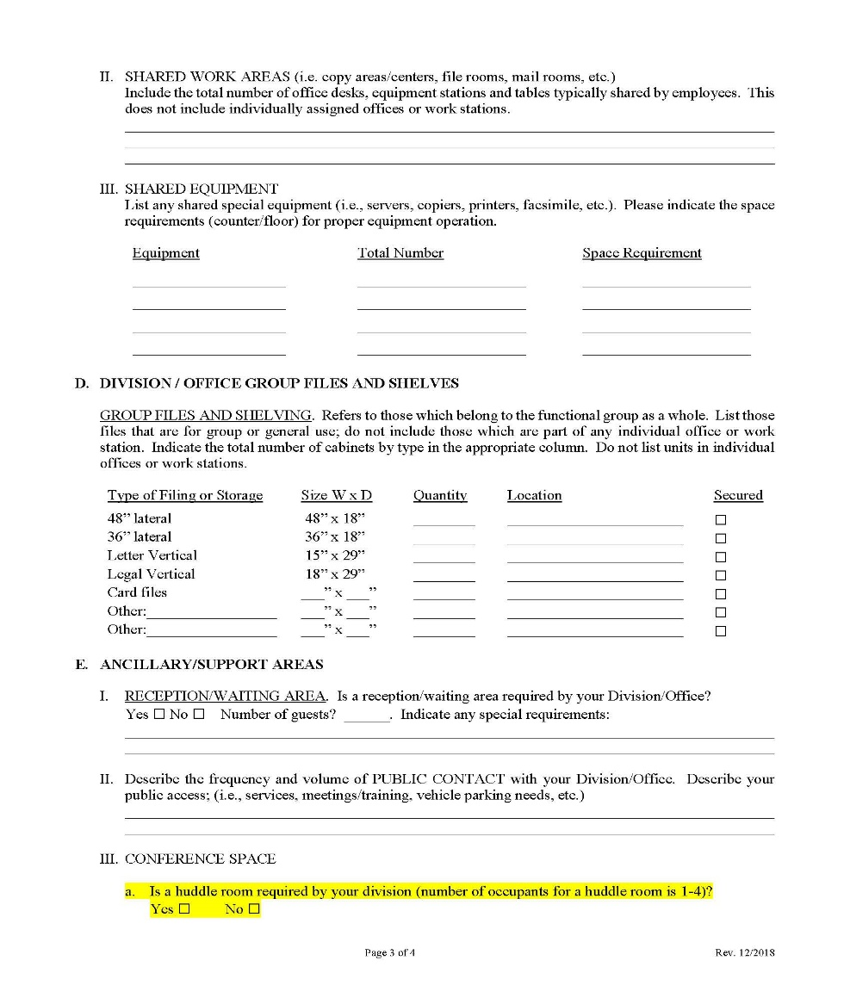
REVISIONS TO SPACE UTILIZATION QUESTIONNAIRE
Page 3:
Section E. III a.
The Huddle Room size will remain at 100 sf.

Slide 13
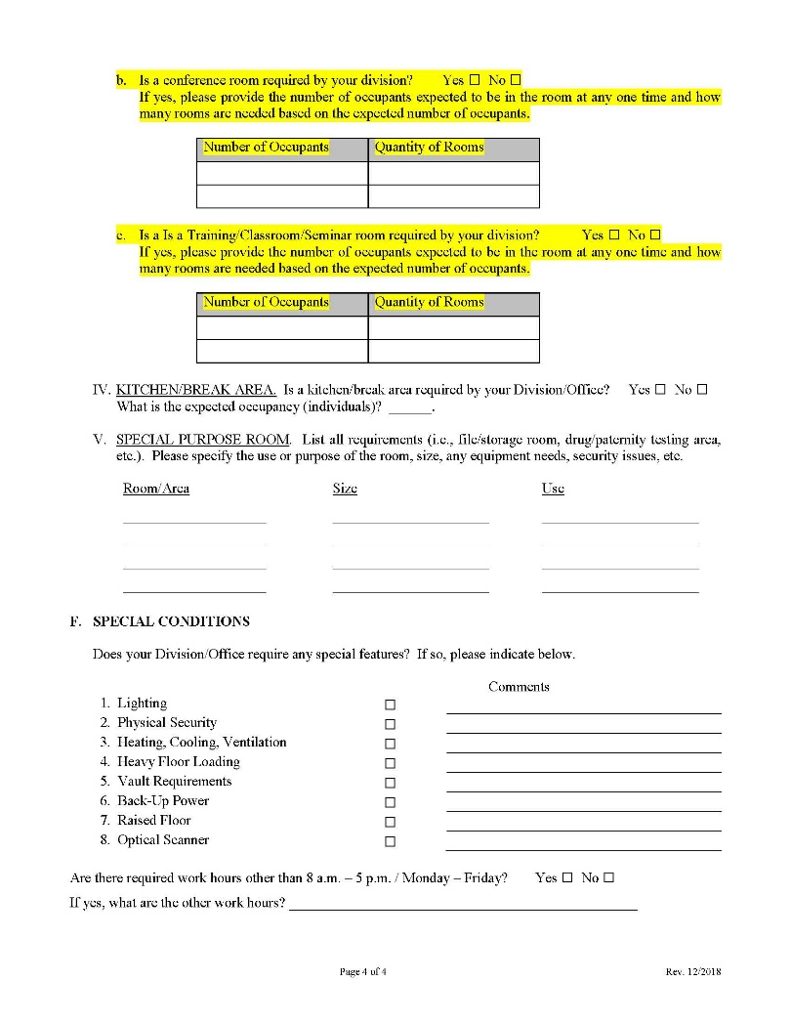
REVISIONS TO SPACE UTILIZATION QUESTIONNAIRE
Page 4:
Section E. III – b and c
These subsections were revised in order for agencies to provide the intended occupancy of any needed conference rooms, training rooms and classrooms. Space Management will program the space based on the number of occupants.

Slide 14

SPACE MANAGEMENT TEAM
All Space Management forms can be found on SPC’s website at
spc.ga.gov
If you have any questions contact:
Alisa Pereira
alisa.pereira@spc.ga.gov
Ginette Tatem
ginette.tatem@spc.ga.gov
Timothy Barker
tim.barker@spc.ga.gov
Susann Haddad
susann.haddad@spc.ga.gov

Slide 15
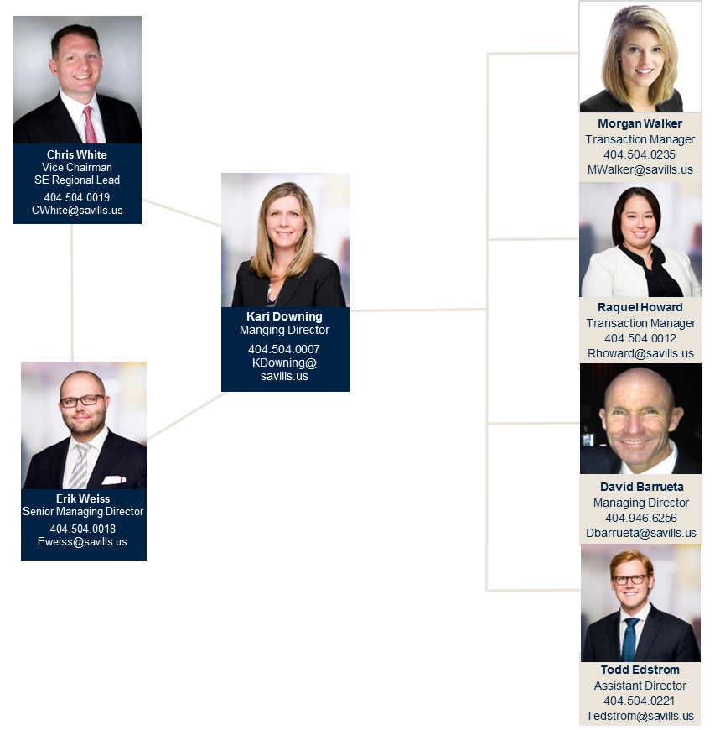
SPC CONTRACT BROKER TEAM (SAVILLS)
Notes:
Place prospect/client logo in Logo box above and adjust flow to accommodate specific structure. Maximum logo size 1.0” x 1.0”.

Slide 16
QUESTIONS

