Slide 1

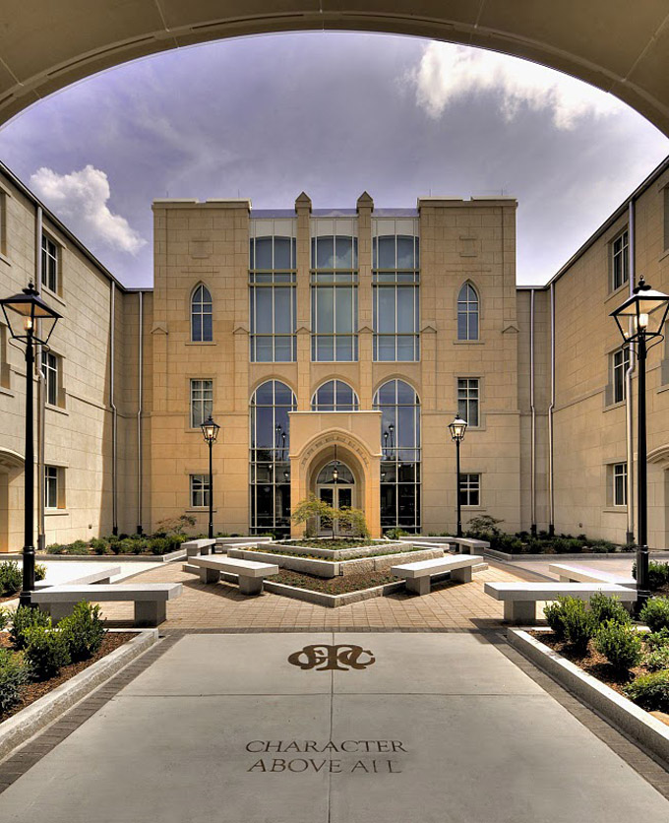

State Properties Commission
Real Property Portfolio Management
Mission:
To advise, guide and maximize Georgia’s real estate portfolio by applying industry best practices in asset, space and transaction management
LEASING  SPACE PLANNING/DESIGN  ASSET MANAGEMENT  LAND ACQUISTIONS & DISPOSITIONS

Slide 2
State Properties Commission
Real Property Portfolio Management
Agenda
Welcome- Alisa Pereira, Assistant Director
Transaction Management- Land Division
    Announcements and Deadlines- J. Wade
Transaction Management- Leasing Division
    GTA Telecommunication Process- Dean Johnson, Chief Operating Officer, GTA
Asset and Portfolio
    Insurance Premium Renewal and Follow-Up to Tropical Storm Hermine & Hurricane Matthews for locations with and without Insurance Coverage- Frederick Trotter
Q & A

Slide 3
State Properties Commission
Real Property Portfolio Management
Transaction Management- Land Division
    Announcements and Deadlines- J. Wade

Slide 4
State Properties Commission
Real Property Portfolio Management
Transaction Management- Leasing Division
    GTA Telecommunication Process- Dean Johnson, GTA

Slide 5
State of Georgia
IT Contracts and Service Offerings
Dean Johnson
Chief Operating Officer, GTA
SPC REMAT Meeting
GSFIC Training Room - 1st floor TW building
December 7, 2016
Notes:
5

Slide 6
Georgia Technology Authority
Collaboration through Partnerships
Leveraging Core Competencies in State Government

Slide 7

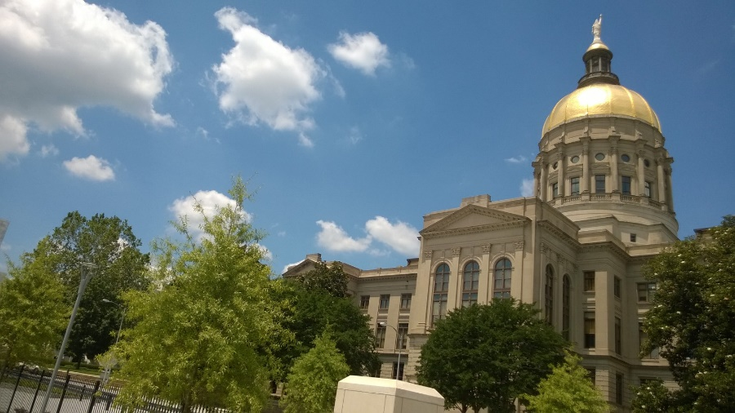

What is the Georgia Technology Authority?
Delivers IT services and support
to executive branch agencies and beyond
  Extends many services across broader slate of Georgia agencies
Manages the state’s
central IT infrastructure
  Data center, network and
  telecomm services, security
Promotes an enterprise
approach to state IT

Slide 8
Enterprise Approach to State IT
Managed Network Services
  Telecom/voice services
  Network connectivity
IT Infrastructure Services
  Desktop computing
  Laptops
Security Policies & Standards
Enterprise Software & Hardware Contracts
IT Project Oversight
Governance Standards for Enterprise Applications
State Portal (georgia.gov)
  Cabling
  Software & security included
  Maintenance & refresh
Notes:
GTA’s enterprise approach to IT management includes:
- Managed network services,
- Infrastructure services,
- Security policies and standards,
- Enterprise contracts that are available for all agencies and local governments,
- IT project oversight,
- Enterprise applications governance standards,
- Printing services,
- State portal (screen shot in appendix).

Slide 9
GTA Organization
Calvin Rhodes
Executive Director and
Chief Information Officer
Joe Webb
Deputy Director
Stanton Gatewood
Chief Information Security Officer
Dean Johnson
Chief Operating Officer
Debbie Smith
HR
Paula Calhoun
Communications
Michael Curtis
Enterprise Governance and Planning
Steve Nichols
Chief Technology Officer

Slide 10
State Portal
Steve Nichols
Chief Technology Officer

Slide 11
Portal Division Overview
GTA is responsible for www.georgia.gov web presence
Manages content management system for 78 public-facing agency websites, including Governor’s Office, Lt. Governor, and Attorney General
Develops and hosts 25 web applications for agencies, including Sex Offender Registry
Develops and hosts 44 data integration connections between agency applications, including GBI-Georgia Crime Information Center

Slide 12
Enterprise Governance and Planning
Michael Curtis
Director of IT Planning and Strategy

Slide 13
Enterprise IT Governance
Mission: Enable enterprise IT decision making
Define
Educate
Monitor
Improve
Create the framework for IT decisions
Provide awareness and understanding
Assure compliance with IT frameworks
Measure outcomes of governance

Slide 14
Governance and Risk Management
Mission: Deliver policies to guide agencies’ use of technology
  Enterprise standards based on industry best practices
  Governance to foster successful outcomes
  Board approval process

Slide 15
Cyber Security
Stanton Gatewood
State Chief Information Security Officer
Office of Information Security (OIS)

Slide 16
GTA Office of Information Security
Cybersecurity Governance, Risk and Consulting
Cyber-Intelligence
GTA Information Security Officer
GETS Information Security Officer
Georgia Cybersecurity Academy
Office of the State Chief Information Security Officer

Slide 17
Georgia Enterprise Technology Services (GETS)
Dean Johnson
GTA Chief Operating Officer

Slide 18
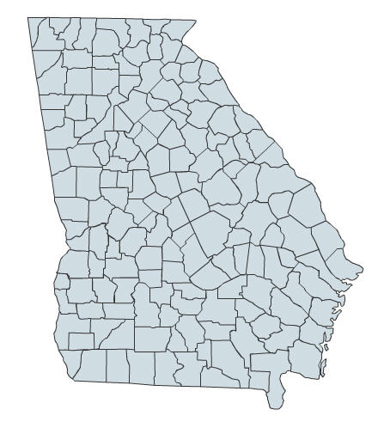
Georgia Enterprise Technology Services (GETS)
GETS is the state’s privatization initiative for infrastructure and network services
  Administered by Georgia Technology Authority (GTA)
  Over 100,000 users spread across 1,400 state agencies and municipalities for managed network services
  35,000 IT infrastructure end users
  47,000 email accounts
  1.5 PB of storage space
  3,500 servers

Slide 19
GTA Customers – GTA Services
Who we serve
What we deliver
1,400
Network
Phone Service
1,400 At Will
100,000+ users
Phone Service
Network
Mainframe
Security
Servers
Policies & standards
85 Executive Branch
58,000+ users
85
Phone Service
Network
Mainframe
Security
Servers
Policies & standards
Desktops & laptops
Disaster Recovery
14 GETS
36,000+ users
14
Notes:
-Local and federal government offices are GTA customers: 1,400 at-will customers
-85 executive branch agencies
-15 GETS agencies represent about 80% of IT spend in state government

Slide 20
GTA’s Sourcing Management Organization (SMO)
The business we’re in:
Understand customers’ business needs,
then deliver IT services that best meet those needs.
  Manage relationships with GETS service providers
  and customers
  Manage risk and deliver value
  Serve as trusted advisor to GETS agencies
  And we approach it as a business.

Slide 21
GETS is an evolving program
The original GETS contracts with IBM and AT&T established an enterprise model for purchasing IT services
  Take advantage of aggregate purchasing power
  Use shared savings to fund investments in IT transformation
Now pursuing a phased approach to improve the enterprise model
  Provide shared environment, tools and processes,
  and cultivate shared commitments
  Promote competition by enabling more specialized providers to participate
  Foster improved performance and innovation

Slide 22
GETS Shared Services Platform Timeline
Evolve the platform – competitive, accountable, and secure
2016 |  | 2017 |  | 2018 |  | 2019
Infrastructure Re-procurement
Infrastructure Transition
Ongoing Market Testing
Integration Alignment
Piloting new services
Add New Services
Piloting new customers
Add New Customers
Infrastructure Contract (IBM)
IBM Option Years - Infrastructure
DC Lease Evaluation
(Expires 2023)
Georgia Technology Authority

Slide 23
GETS Shared Services Delivery Model
Features
Plug-and-play model
Emphasis on service delivery, transparency and innovation
Healthy “co-opetition” among service providers
Common way of doing business, across multiple providers
Quick response to changing needs
Strong governance structure, with heavy involvement from GETS agencies

Slide 24
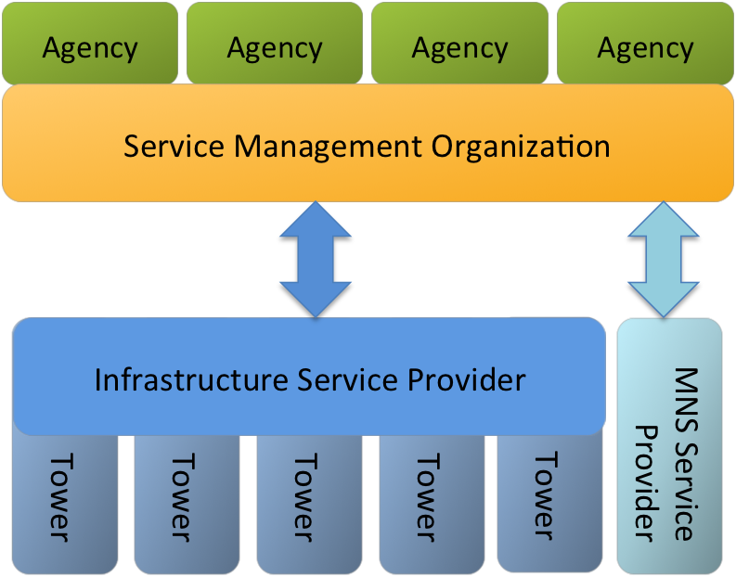
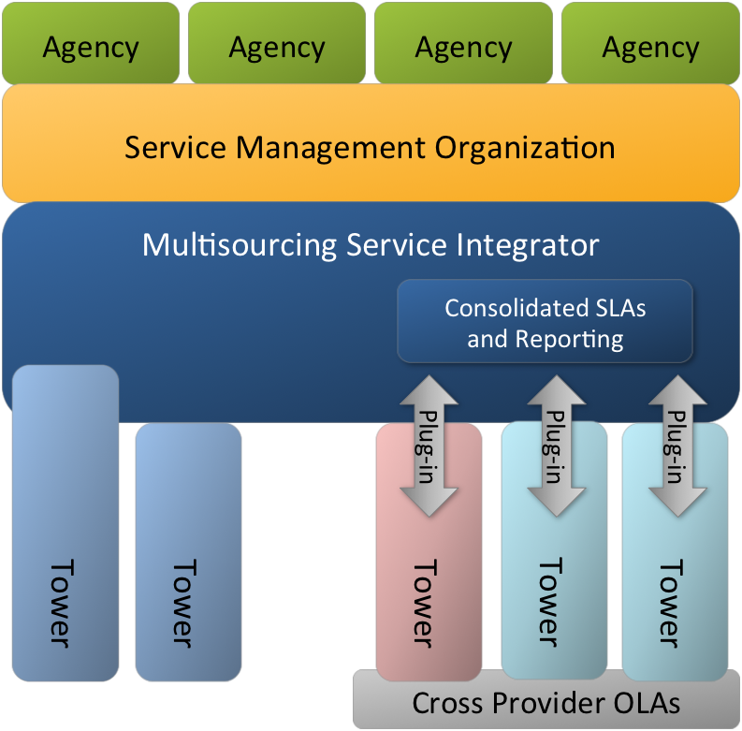
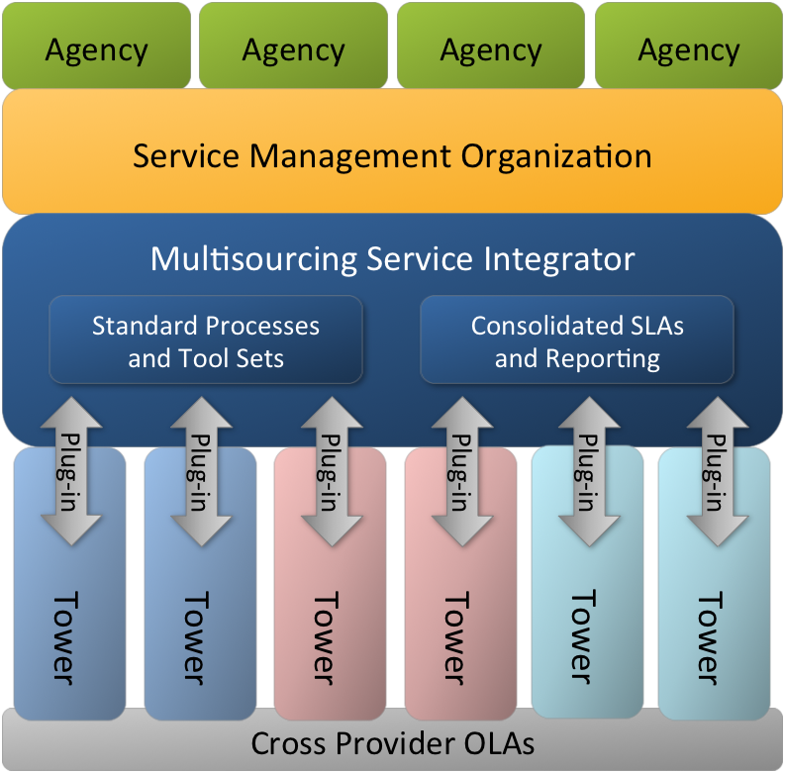
Getting to a true plug & play model
Enterprise contracting
Integrated Services Platform: iterative build
Sourcing Management Organization
Sourcing Management Organization
Sourcing Management Organization
Secure, Reliable, Recoverable
Transition
Flexible State
Transition
Incumbent Realignment
Shared Platform
Plug & play capability
Process improvement
Program of Parallel Procurements
SMO maturation

Slide 25

GETS business priorities
Continue providing secure, reliable and recoverable services, with added focus on timeliness
Increase GETS value by bringing services to more customers
Offer cost-competitive services
Improve the customer experience

Slide 26

GTA has become an IT services broker
Matches agency business needs
to best-suited services IT market has to offer
Delivers services via flexible, adaptable GETS platform
Brings new services to even more customers
Takes business-like approach

Slide 27

Dean Johnson
Chief Operating Officer
Georgia Technology Authority
47 Trinity Avenue
Atlanta, GA 30334
Dean.Johnson@gta.ga.gov
404-463-4409

Slide 28
State Properties Commission
Real Property Portfolio Management
Asset Management
    Insurance Premium Renewal and Follow-Up to Tropical Storm Hermine and Hurricane Matthews for location with and without Insurance Coverage- Frederick Trotter

Slide 29
PROPERTY PROGRAM
RISK MANAGEMENT – FREDERICK TROTTER
SPC REMAT PROPERTY DISCUSSION

Slide 30
Property Insurance Program
FY17 Property Insurances Values
SOG Windstorm Exposure
  Tropical Storm Hermine
  Hurricane Matthew
FY18 Property Insurance Renewal Updates

Slide 31
Property Insurance Program Values
Unit | FY16 Expired Property Values | FY17 Current Property Values | % Change
Building | $25,801,964,192 | $26,451,788,662 | 2.52%
Contents | $5,803,348,256 | $5,766,915,126 | -0.63%
Total Property Damage | $31,605,312,447 | $32,218,703,788 | 1.94%
Business Interruption | $856,893,497 | $886,362,873 | 3.44%
Grand Total | $32,462,205,944 | $33,105,066,661 | 1.92%

Slide 32
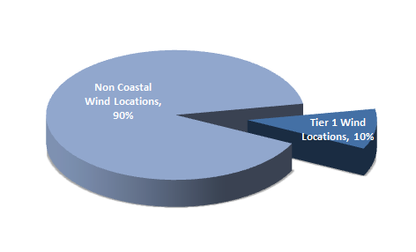
Property Program Windstorm Exposure

Slide 33
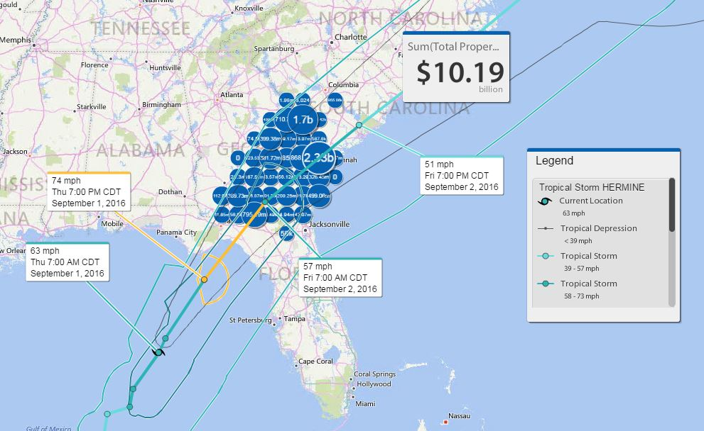
Tropical Storm Hermine Projection 09/01/16

Slide 34
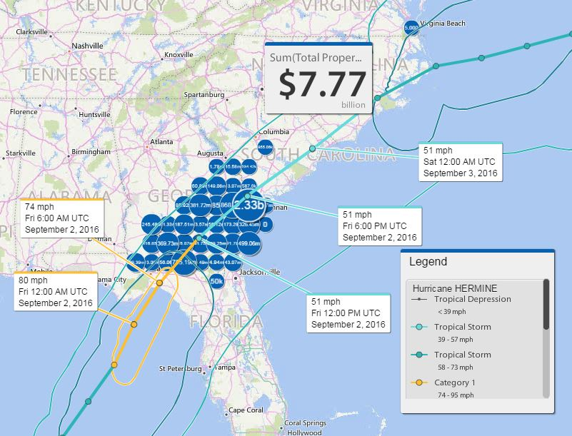
Tropical Storm Hermine Projection 09/02/16

Slide 35
Tropical Storm Hermine Property Damages
Four (4) Agencies Incurred Property Damages
  Primarily high wind damages
  Eleven (11) claims
  Total 15 insured structures damaged
  Total Incurred damages
    $136,855

Slide 36
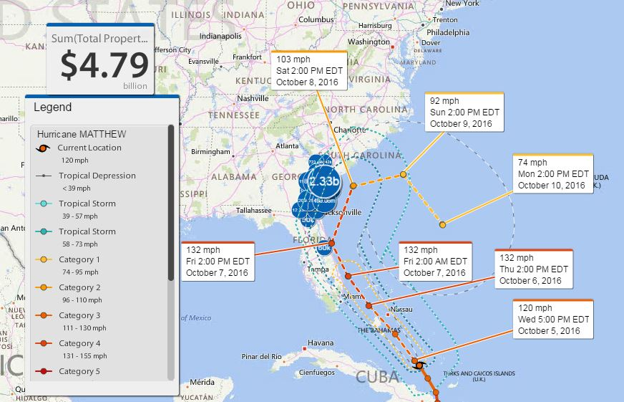
Hurricane Matthew Projection 10/05/16

Slide 37
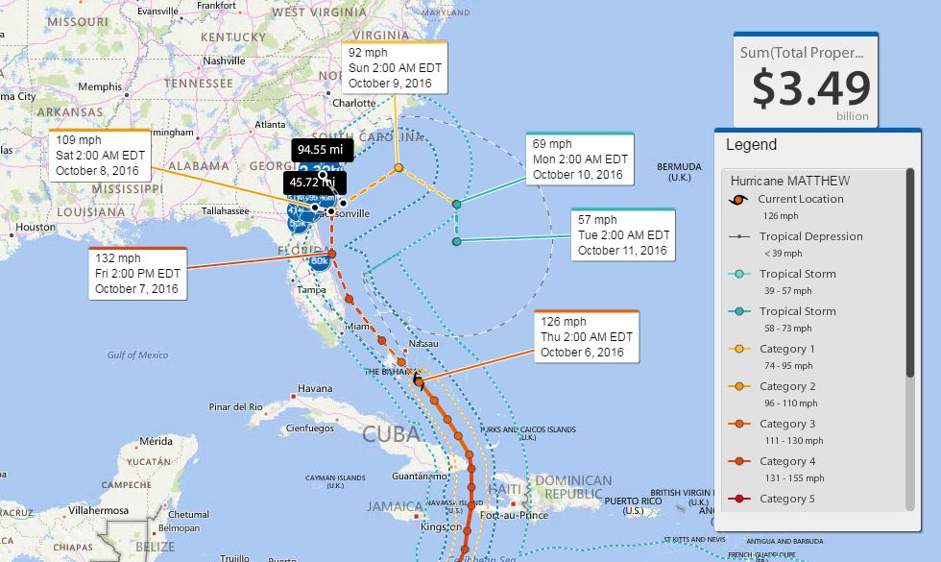
Hurricane Matthew Projection 10/06/16

Slide 38
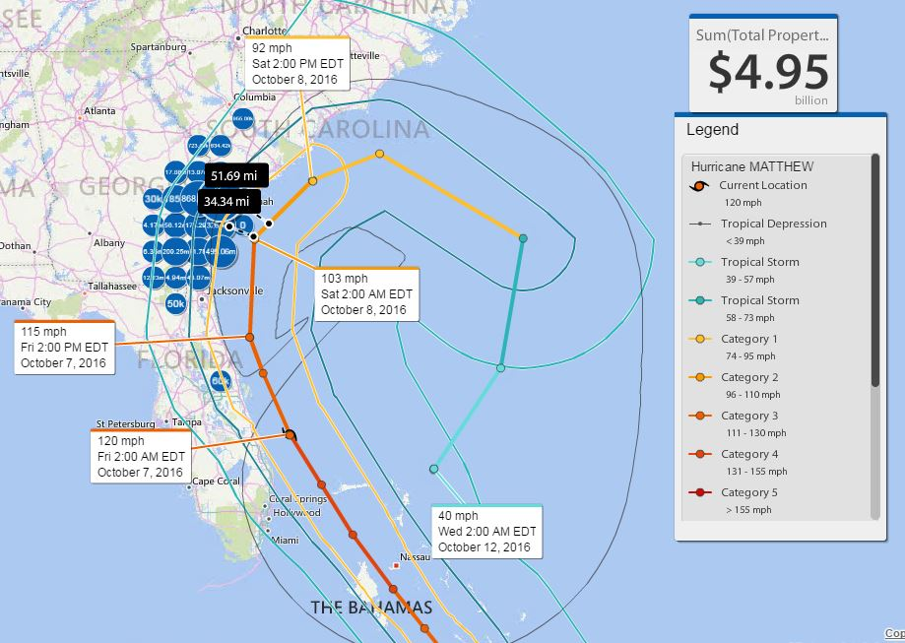
Hurricane Matthew Projection 10/07/16

Slide 39
Hurricane Matthew Estimated Property Impact
Nine (9) Agencies Incurred Property Damages
  Primarily high wind / flood damages
  Thirty – Six (36) locations
  Total 276 structures / items damaged
  Total estimated damages
    $ 8,164,024.00

Slide 40
Hurricane Matthew Projected Property Impact
Thirty – Four (34) structures had no assigned BLLIP ID
  One structure was a new location for FY17
    Pole Barn Building estimated damages $14,000 ( covered loss)
  Thirty – three (33) structures:
    Confirmed no assigned BLLIP ID
    Not recorded in BLLIP prior to loss date
    Agency elected not to cover structure
    Total estimated losses
      $1,712,750

Slide 41
FY 18 Property Insurance Renewal Update
Targeted Coverage Renewal Periods
Building & Contents
  Same format as FY17 whereby agencies can either update the BLLIP register directly or
  Request your agency BLLIP data to be downloaded to a spreadsheet template via ITOS
  Spreadsheet templates for FY18 will only reflect the critical fields required for updating
  Please note downloaded templates fields can not be altered and or changed
  DOAS / ITOS will host building & contents webinars based on interest
  Renewal Period - December 12, 2016 thru February 24, 2017
Special Property All Risk
Business Interruption Worksheets
  Renewal Period - December 12, 2016 thru February 24, 2017
Aviation Fleet
Ocean Marine Fleet
  Renewal Period – January 9, 2017 thru February 24, 2017

Slide 42
Contact Information
    Risk Management Services
    200 Piedmont Ave, SE, Suite 1208 West
    Atlanta, GA 30334
    Wade Damron, Director
    Wade Damron@doas.ga.gov, 404-463-7982
    Frederick Trotter, Property Program Officer
    Frederick.Trotter@doas.ga.gov, 404-463-2143
    Kim Cramer, WC Program Officer
    Kim Cramer@doas.ga.gov, 404-656-9484
    Mark McKinney, Liability Program Officer
    Mark.McKinney@doas.ga.gov, 404-656-4817
    C.G. Lawrence, Safety and Loss Control Officer
    Charles.Lawrence@doas.ga.gov, 404-657-4457
    Hiram Lagroon, Safety and Loss Control Officer
    Hiram. Lagroon@doas.ga.gov, -404-6536309
Website: www.doas.ga.gov

Slide 43

Questions & Answers

Slide 44
404.656.6245
www.DOAS.ga.gov

Slide 45
Contact Information
State Properties Commission
Real Property Portfolio Management
Frank Smith- Deputy Executive Director
Office: (404) 656-5602
Alisa Pereira- Assistant Director
Office: (404) 463-5861
J. Wade- Land Acquisition & Disposition Manager
Office: (404) 463-6161
Tamika Crittenden- Leasing Section Manager
Office: (404) 463-5570
Andre’ Elam- Business Analyst
Office: (404) 463-6443
Note: A copy of this REMAT Presentation can be obtained at http://gspc.georgia.gov/publications

