Slide 1
Certification of Ownership
For questions or additional information, contact
J. Wade – Phone: (404) 463-6161 – Email: j.wade@spc.ga.gov
Clark Wong – Phone: (404) 656-2360 – Email: clark.wong@spc.ga.gov
Forms and samples will be made available at
http://gspc.georgia.gov/property-acquisition-and-disposition

Slide 2
Introduction
Certification of Ownership: The evidence of ownership in inventoried deeds in the name of the State of Georgia.
SPC has been tasked with the responsibility of Certifying State Owned Property, prior to the commencement of construction activities.

Slide 3
Purpose
The purpose of the Certification process is to ensure the limits of construction are only on State property. This is done by analyzing the deeds, surveys, Limits of Construction, and other supporting documents for any issues that may
adversely effect the States interest
Avoid improper use of Bond Funds
result in the State encroaching on another property owner or easement holder

Slide 4
Subject to Certification
Properties meeting any of the following tests are required to obtain Certification prior to commencing any construction activity
Any project utilizing G. O. (General Obligation) Bonds
Any project exceeding $1,000,000 in design and construction costs

Slide 5
Exempt from Certification
Projects exempt from Certification requirements must meet one of the following tests:
not using G.O. Bonds, and having less than $1,000,000 in design and construction costs
being constructed entirely within the footprint of a building that was previously certified
*Although projects meeting the above tests are exempt, it is strongly recommended by SPC that Review still be obtained

Slide 6
Required Documents
The following documents are required as part of the Certification Request, and should be packaged in the following order:
Completed “Certification Instructions & Checklist”
Certification Request letter
Plot Plan
Deed(s)
Original Survey(s)
Aerial Map
Location Map

Slide 7
“As Needed” Documents
Depending on the circumstances of the project or deeds, the following supporting documents may be required
Copy of existing Easement Agreement(s), not mentioned in the deed that vested the State in ownership
Encroachment agreement from Easement Holder if improvements encroach on easement area

Slide 8
Additional Supporting Documents
Other supporting documents may be included to give additional detail, if warranted. Examples may include:
Topographical Surveys
Civil drawings
Architectural drawings
Erosion & Sediment Control drawings
Any other documents that help give clarification

Slide 9
Analysis
After SPC receives the Certification Request, we analyze each of the attachments, looking for potential issues that could diminish the States claim to title, or to avoid improper use of Bond Funds
Certification Instructions & Checklist should be completed per instructions, with appropriate boxes checked
Certification Request Letter should be submitted in format similar to Sample

Slide 10
Analysis
Deeds
Only submit deed or deeds that vest ownership in the State in tracts where any portion falls within the Limits of Construction.
For example, if 20 deeds make up a 1,000 acre college campus, but the Limits of Construction only covers all (or a portion of) 2 of the 20 tracts, only include deeds for the 2 tracts that are to be effected.

Slide 11
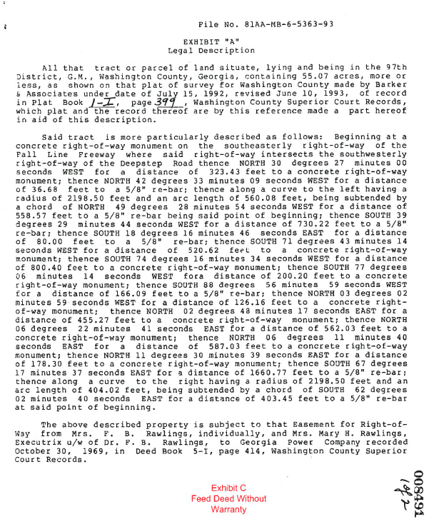
Analysis
Deeds
SPC will analyze the deeds to:
Identify any encumbrances
Existing easements

Slide 12
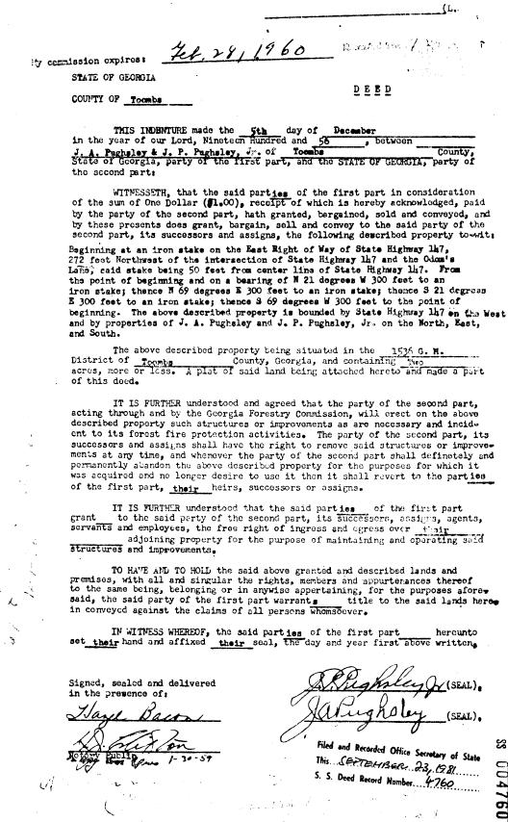
Analysis
Deeds
SPC will analyze the deeds to:
Identify any encumbrances
Existing easements
Reversionary clauses

Slide 13
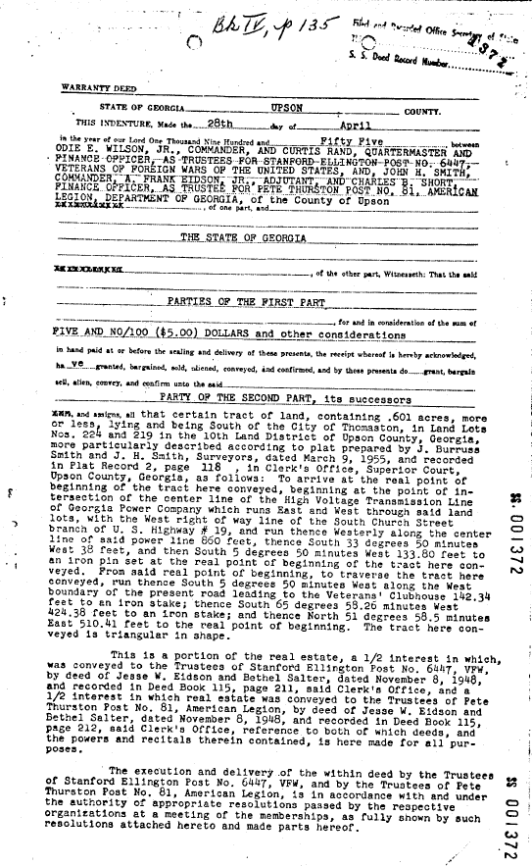
Analysis
Deeds
SPC will analyze the deeds to:
Identify any encumbrances
Existing easements
Reversionary clauses
Divided Interests

Slide 14
Analysis
Deeds
SPC will analyze the deeds to:
Identify any encumbrances
Existing easements
Reversionary clauses
Partial Interests
Exceptions
Obvious Clouds or breaks in chain of title

Slide 15
Analysis
Deeds
SPC will analyze the deeds to:
Verify name of Grantor matches Signatory
Verify State (or Custodial Agency if appropriate) is named as Grantee
If any adverse issues are discovered, SPC will assess the severity and potential impact, and establish a plan of action for resolution

Slide 16
Analysis
Surveys
Submit the survey(s) referenced in each incoming deed
Submit any survey(s) prepared for any portion of the project site, since it was vested in the State
If a new survey is prepared as part of the Project, include it as part of the Required Documents
*For any tract in which a portion lies within the Limits of Construction, there MUST be a corresponding survey covering that tract, in its entirety. The Plot Plan should normally satisfy this requirement.

Slide 17
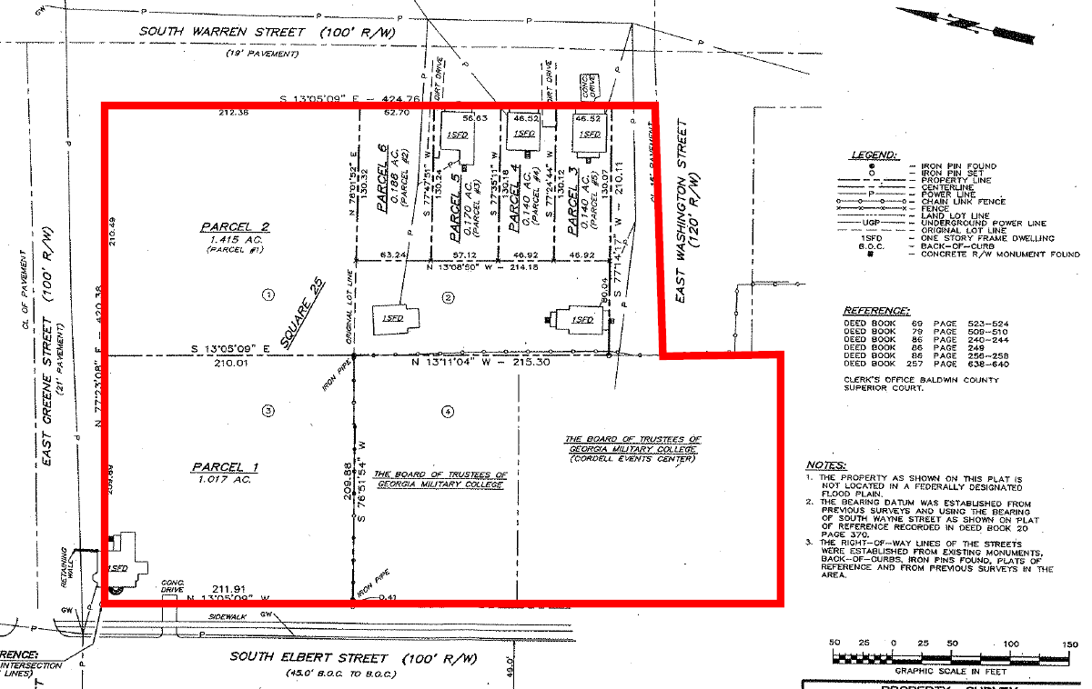
Project Area
These tracts appear on the survey, but their legal descriptions are not complete, and DB & Pg #’s are not referenced.
There should be an additional page to the survey, or a separate survey altogether that describes them

Slide 18
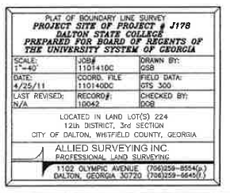
Analysis
Plot Plan/Surveys/Engineered Drawings should include
Stamp and signature of the Engineer or Surveyor, and effective date of drawing

Slide 19
Analysis
Plot Plan drawings should include
All areas to be disturbed, erosion control, maintenance buffer for erosion control, any areas that must be tested, inspected or observed for runoff from the site, or any area in which the GC must have access to in order to carry out all of their assigned responsibilities

Slide 20
Analysis
Plot Plan drawings should include
Boundary Survey with parcel lines indicating each parcel making up the overall property/campus
Or scale Plot Plan and overlay on top of original incoming survey(s)
The reason for this is to verify there are no off-site improvements, and to identify the specific deeds that need to be included in the submission

Slide 21
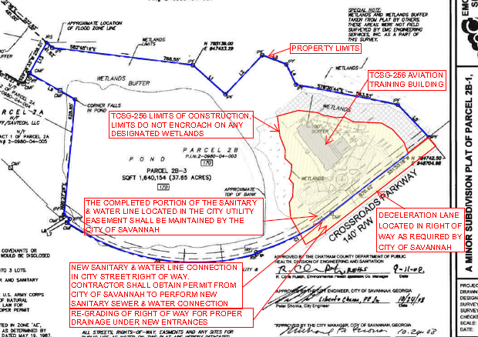
Original Incoming Survey
With Metes & Bounds

Slide 22
Analysis
Plot Plan drawings should include
Metes & Bounds descriptions for each tract
Legal description on survey should match the legal description in the incoming deed
Metes & Bounds Legal Description on all parcels

Slide 23
Analysis
Plot Plan drawings should include
Parcel lines for each tract, based on the legal description of EACH incoming deed
Parcel Lines for each tract

Slide 24
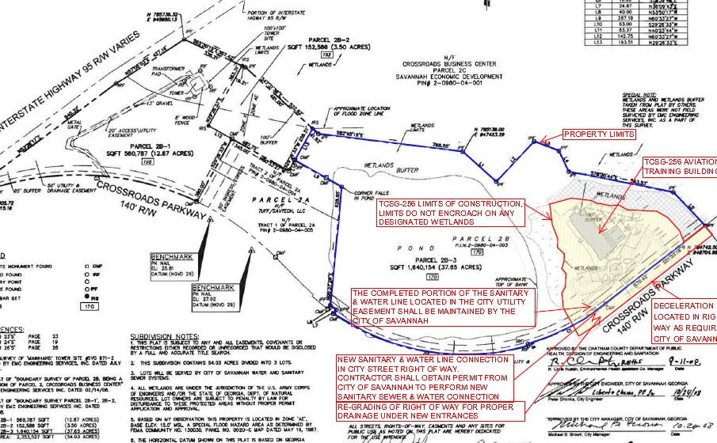

Slide 25
Analysis
Plot Plan drawings should include
Reference each tract with the Deed Book and Page number of the deed vesting that tract into the State
DB & Pg #’s for each incoming deed

Slide 26
Analysis
Plot Plan drawing should include
Footprint of all existing and proposed buildings, and indicate which are existing, proposed, and slated for demolition
Proposed Aviation Training Center

Slide 27
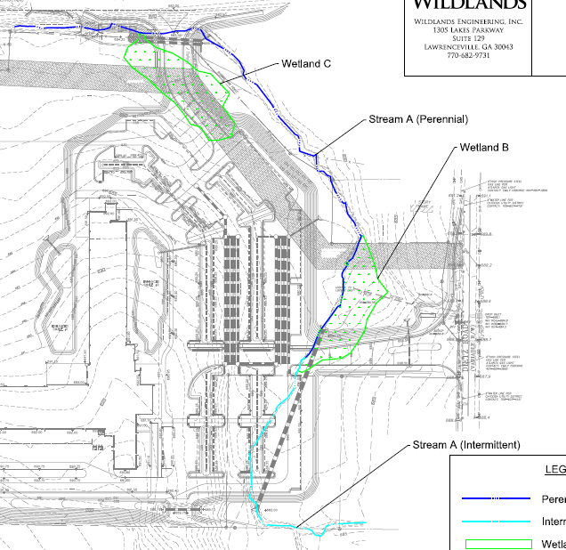
Analysis
Plot Plan drawing should include
Streams, Rivers, Creeks, Right of Ways and their respective buffers
`

Slide 28
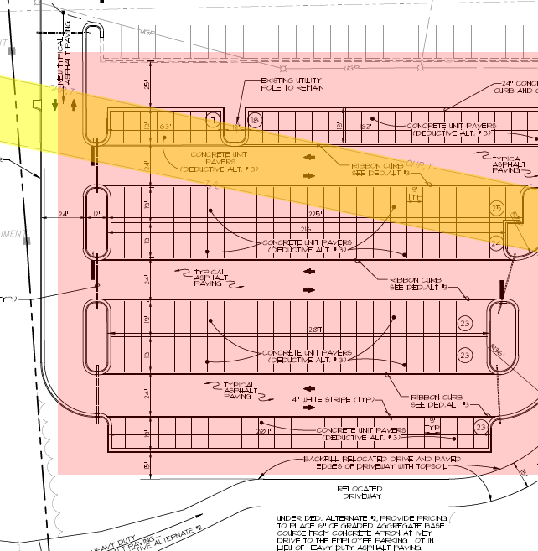
Analysis
Plot Plan drawing should include
Highlight existing easements
Existing Power Easement

Slide 29
Analysis
Plot Plan drawing - Potential issues
Encroachments
Improvements in right-of-way
Disturbance of buffer areas
Discrepancy between original survey parcel lines and current survey parcel lines
No work should take place outside the Limits of Construction

Slide 30
Analysis
Plot Plan drawing - Potential issues
Existing Easements
If an existing easement covers any portion of any tract falling within the Limits of Construction, a copy of the easement document needs to be furnished to SPC.
If the easement existed when ownership was vested in the State, the legal description most likely appears as an Exception in the vesting deed

Slide 31
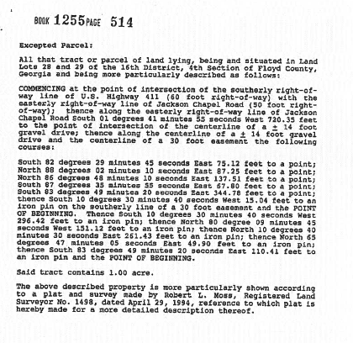

Slide 32
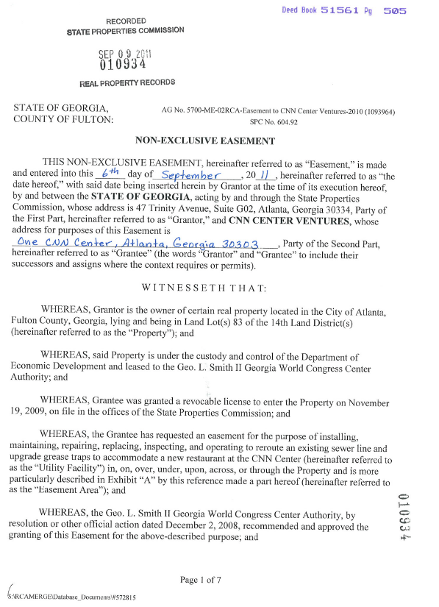
Analysis
Plot Plan drawing
- Potential issues
Existing Easements
If the easement was created after the property was vested in the State, a separate easement document should have been fully executed, and recorded

Slide 33
Analysis
Aerial Map
- Potential issues
If a site visit or aerial shows clearings that indicate a power or gas line easement may encumber the property, the Easement Document should be found and included in the Certification Request.
Visual Signs of possible Easement

Slide 34
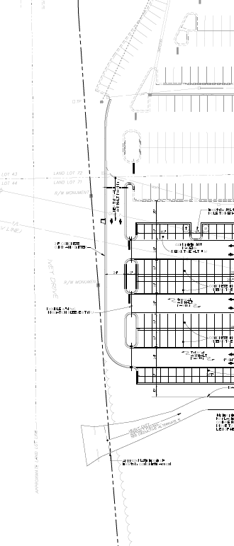
Analysis
Plot Plan drawing - Potential issues
Easements depicted in or near Project site
Power Easement
Power Easement

Slide 35
Analysis
Plot Plan drawing - Potential issues
Encroachment Agreement
If any portion of the proposed structure, or disturbance activities, (like the parking lot in the previous slides) encroach into an existing easement area, an encroachment agreement may need to be obtained from that easement holder

Slide 36
Analysis
Plot Plan drawing - Potential issues
Discrepancies in roads and right of ways between old and current surveys
Notice distance between parking lot curb & road.
Had to be sure property line was correct since road changed, and be sure we had permission to make improvements within ROW
Proposed Road
ROW was property line
Notice curvature in road
Road as built
Notice road was straightened

Slide 37
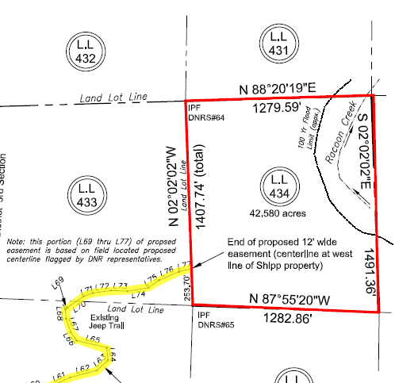
Analysis
Plot Plan drawing
- Potential issues
Gaps between property lines, leaving landlocked property not under State ownership, within the Project site
Inholding at
Sheffield WMA
Surrounded on all sides
by State Owned Property

Slide 38
Analysis
Plot Plan drawing – Granting of RLA’s & Easements
Almost every project will require utilities to come on State owned property
A lot of concern has been placed on when an RLA is needed and when an Easement must be issued

Slide 39
RLA’s & Easements
RLA & Easement – when they’re needed
If any party not under c0ntract with the General Contractor needs to come on State owned property to do work (install or upgrade utility service), a RLA is required.
If any party will retain an interest/ownership of facilities placed on State owned property (meaning the utility owns and/or maintains the lines or equipment), an RLA and Easement must be requested

Slide 40
RLA’s & Easements
RLA & Easement - when they’re needed
Almost every utility line will need an easement
The rare exception is if the State/Agency will own, inspect, maintain and repair the utility line. Large college and hospital campuses are the most common scenarios where this situation exists.

Slide 41
RLA’s & Easements
RLA & Easement – process
It’s noted that the State can’t FORCE a utility to request an RLA or Easement. To address this reality, a process has been outlined.
Custodial Agency notifies utility that they need to request an RLA & Easement
If utility refuses, is uncooperative or unresponsive, Custodial Agency sends a certified letter with return receipt to utility
If utility still refuses, Custodial Agency retains a copy of certified letter and mail receipt for their records, and forwards a copy of the letter and receipt to SPC to keep on file

Slide 42
RLA’s & Easements
RLA & Easement - requirements for Certification
At the present time, RLA & Easement requests are not required for Certification Requests
If SPC feels an agency is not actively pursuing RLA’s & Easement’s for their projects, they may require an agency to submit RLA & Easement requests before clearing a project for Certification

Slide 43
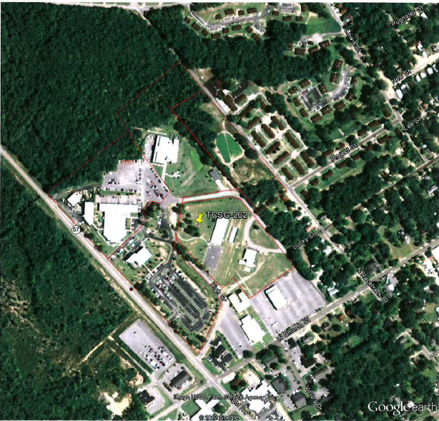
Analysis
Aerial Map
Should show immediate Project site
Indicate location of proposed structures with red dot, or white outline of building footprint
Good resource for Aerial is Google Earth

Slide 44
Analysis
Location Map
Scaled to County level
Indicate with red dot (large enough to see) project site
Good resource is Google Earth or DOT County maps (large file size)

Slide 45
Analysis
Analysis of As-Needed Documents
Title Policy: If a title policy was obtained during, or after acquisition, please provide a copy
*Title Policy may be required on complex properties or when a lack of complete information exists
Examples would include certain Certifications on campuses like Georgia Tech or Georgia State University where overlapping boundaries, incomplete boundaries, incomplete legal descriptions, unrecorded deeds, and breaks in the chain of title have been known to exist

Slide 46
Analysis
Analysis of Additional Supporting Documents
If additional documents are deemed necessary to give clarification to clouded issues
Submit only the necessary documents. Please don’t send 300 pages of Design Drawings
Highlight the area of concern
Make comments to clarify or address concerns

Slide 47
Analysis
Analysis of Additional Supporting Documents
Common supporting documents include
Civil drawings
Architectural drawings
Topographical Surveys
Erosion & Sediment Control drawings

Slide 48
Off-Site Improvements
Often, projects must access property owned by the City, County, DOT, and Private Parties to construct decel lanes, turn lanes, curb cuts, sidewalks, and connect to utilities. These are all considered off-site improvements.

Slide 49
Off-Site Improvements
With the exception of Board of Regents, all agencies must include evidence that permission has been given for the State to improve that property.
For City, County, & DOT property, a permission letter will suffice.
For Private Property, the Custodial Agency must obtain either a Temporary Construction Easement or Permanent Easement, whichever is applicable

Slide 50
Off-Site Improvements Board of Regents
SPC recognizes that Board of Regents
holds title in its own name
has their own system for issuing and obtaining easements
has practices in place for ensuring they do not
improve property not under their ownership or control
Improperly use Bond Funds for off-site improvements

Slide 51
Off-Site Improvements Board of Regents
BOR and SPC have an understanding that
SPC will issue BOR Certifications without requiring adherence to SPC’s standard guidelines and policies with regard to off-site improvements
BOR Certifications shall contain the disclaimer “Please note, this certification does not contemplate any other real property interests which may ultimately be required for the completion and full use of the project, including but not limited to access and utility easements”

Slide 52
Off-Site Improvements Board of Regents
BOR shall be solely responsible for all entitlements involving off-site improvements
SPC shall make no effort to analyze or take responsibility for verifications of any off-site improvements on BOR projects

Slide 53
Delivery of Certification of Ownership
After SPC has reviewed the submission package and resolved any questions, discrepancies or issues, we will issue a Certification of Ownership to GSFIC

