Slide 1
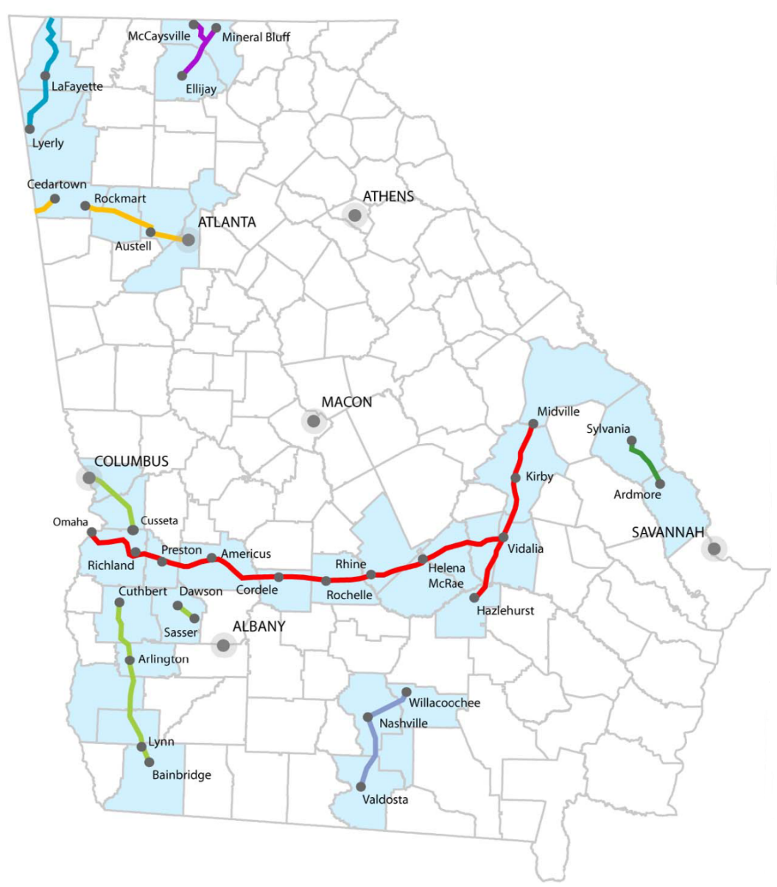
GDOT-Owned Shortline Rail Network
GDOT Owned Railroad ROW | Miles
Heart of Georgia | 249
Georgia Southwestern | 102
Chattanooga-Chickamauga | 49
Georgia Florida | 43
Georgia Northeastern | 25
Ogeechee | 22
Total Shortline Miles | 490
Silver Comet Trail | 45
Total Miles | 535

