Slide 1



State Properties Commission
Real Property Portfolio Management
Mission:
To advise, guide and maximize Georgia’s real estate portfolio by applying industry best practices in asset, space and transaction management
LEASING  SPACE PLANNING/DESIGN  ASSET MANAGEMENT  LAND ACQUISITIONS & DISPOSITIONS

Slide 2
State Properties Commission
Real Property Portfolio Management
Agenda
Welcome- Alisa Pereira, Assistant Director
Asset and Portfolio
    Dept. of Administrative Services (Risk Management Services)- Frederick Trotter and Wade Damron
Transaction Management Remarks- Tamika Crittenden
    Methods to Reduce Your Lease Cost
Land Acquisition & Disposition Remarks- J. Wade
    Policy Update: SPC Streamlined Disposition Process
Q & A

Slide 3
State Properties Commission
Real Property Portfolio Management
Asset and Portfolio Management
Dept. of Administrative Services (Risk Management Services)- Frederick Trotter and Wade Damron

Slide 4
PROPERTY PROGRAM
RISK MANAGEMENT – FREDERICK TROTTER
BLLIP PROPERTY COVERAGE CONNECTION

Slide 5

PROPERTY PROGRAM
BUILDING & CONTENTS COVERAGE
SPECIAL PROPERTY ALL RISK
WATERCRAFT (OCEAN MARINE)
AIRCRAFT
CRIME
AUTOMOBILE PHYSICAL DAMAGE

Slide 6
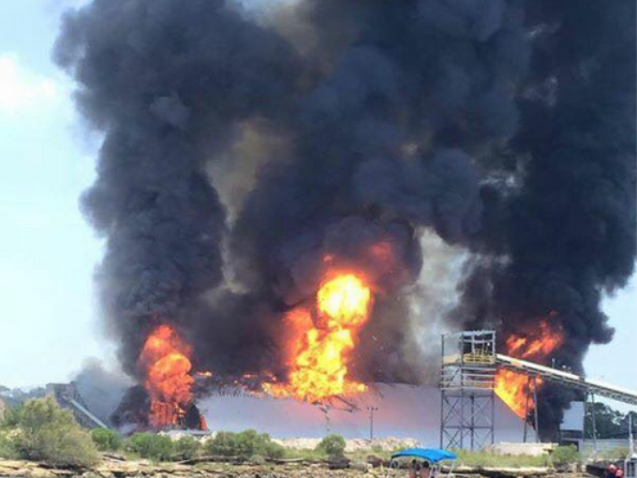

Slide 7
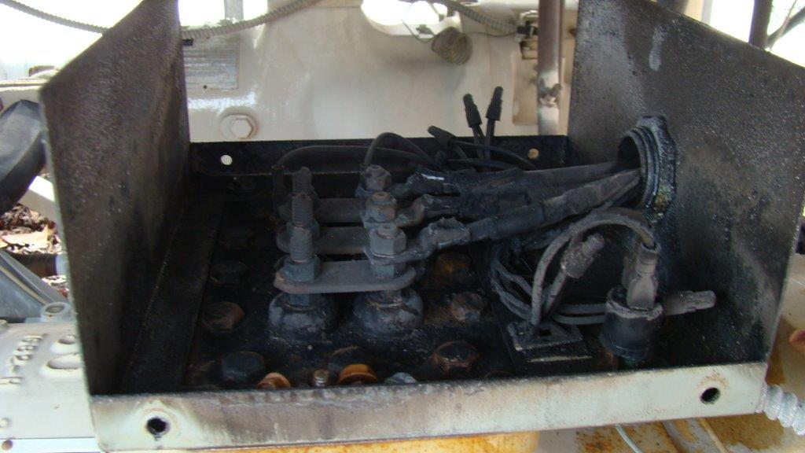

Slide 8
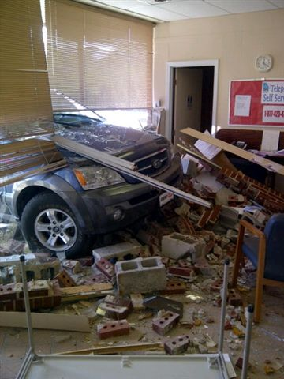

Slide 10
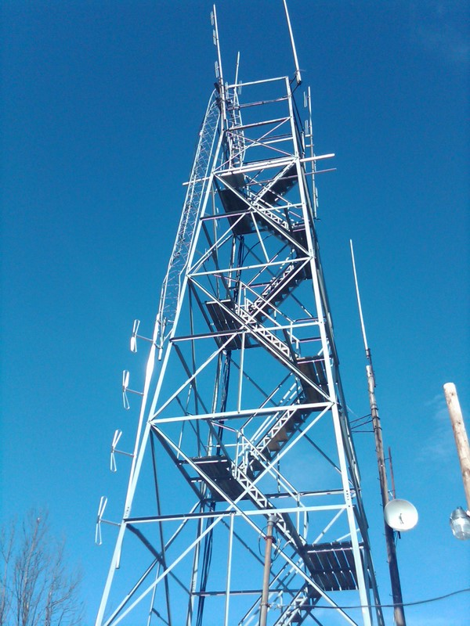

Slide 11
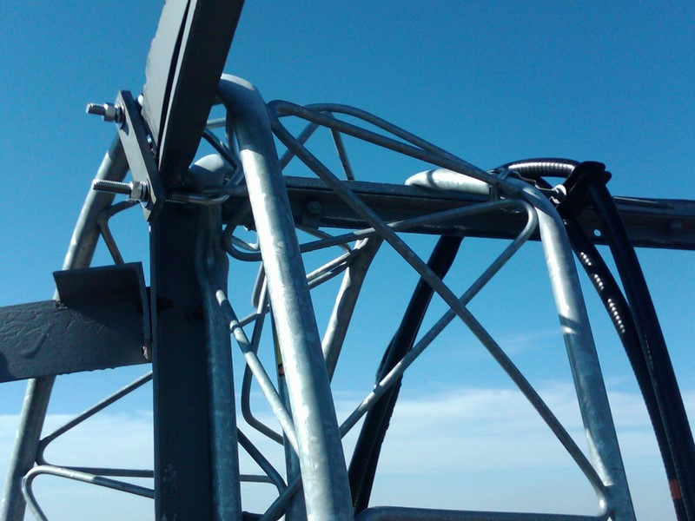

Slide 12


Slide 13
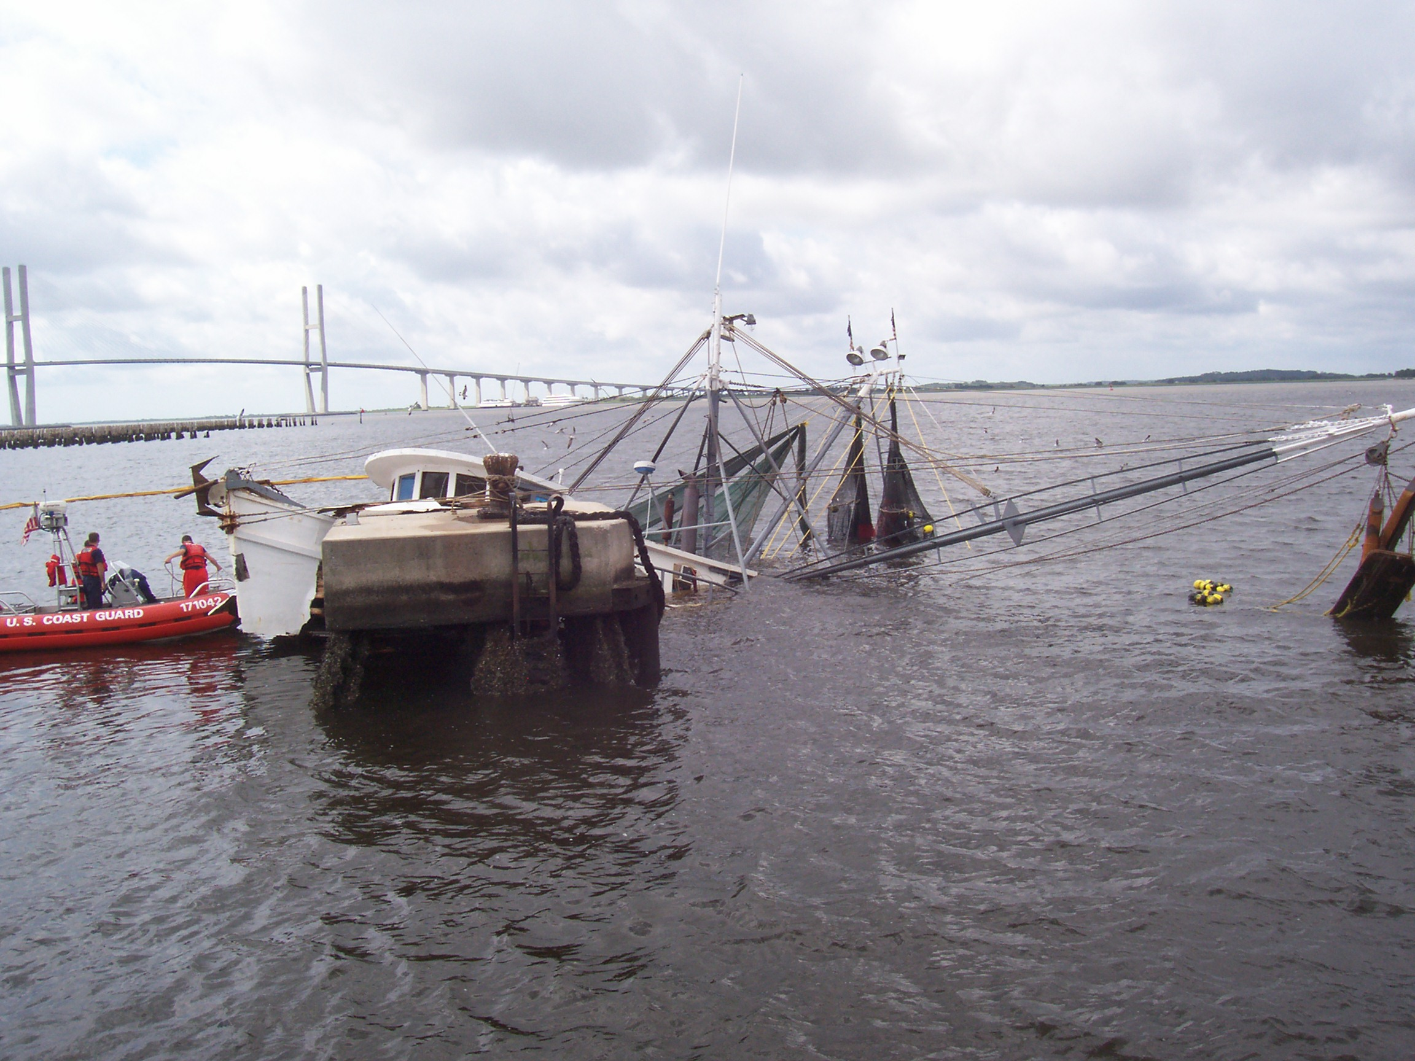

Slide 14


Slide 15


Slide 16
BLLIP / PROPERTY COVERAGE CONNECTION
UTILIZE BLLIP DATA TO CONFIRM COVERAGE VALUATION
RESOURCE TOOL FOR COVERAGE RENEWALS
GENERATE PRE –BILLS/ FINAL INVOICES TO AGENCIES BASED ON BLLIP RECORDS
RMS SCRUB BLLIP DATA FOR ERRORS/MISSING DATA PRIOR TO EXPORTING TO INSURANCE MARKETS
DATA IS EXPORTED TO INSURANCE BROKERS WHO GENERATE MODELS BASED ON HISTORICAL LOSS DATA FOR WINDSTORM, FLOOD, FIRE AND EARTHQUAKE LOSSES
BLLIP DATA, HISTORICAL MODELING, STATE GA LOSS HISTORY IS SUBMITTED TO EXCESS MARKETS FOR GEOCODING / MODELING TO DETERMINE THE ACCURACY OF THE DATA WHICH DETERMINES:
  COVERAGE AVAILABILITY
  RATES/ PREMIUMS
  CONDITIONS OF COVERAGE

Slide 17
VALUE DISTRIBUTION
  Non Coastal Values (Building, Contents= $26,159,581,817.19
  Tier 1 (Building, Contents, & BI) = $2,910,560,051.54
  Total (Building, Contents, & BI) = $29,070,141,868.73
Tier 1 Wind County | TIV
Bryan | $13,367,011.35
Camden | $34,991,815.99
Chatham | $2,300,548,869.77
Glynn | $486.203.526.29
Liberty | $17,820,696.76
McIntosh | $57,628,131.38

Slide 18
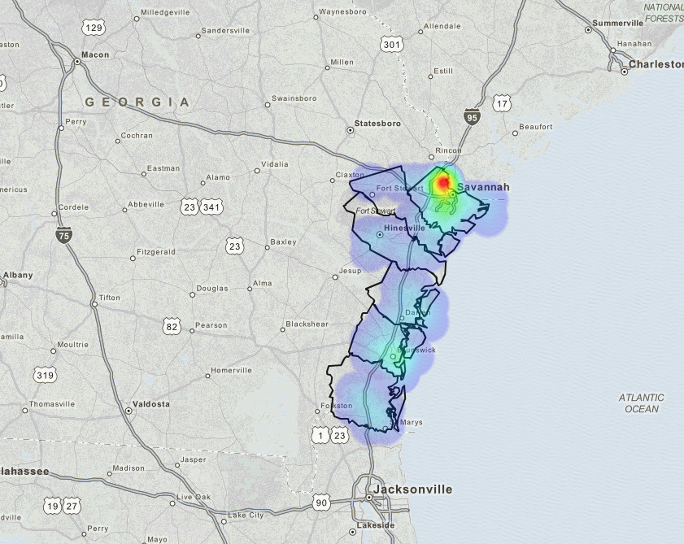
TIV IN TIER 1 COUNTIES

Slide 19
EXPOSURE BY COVERAGE TYPE

Slide 20
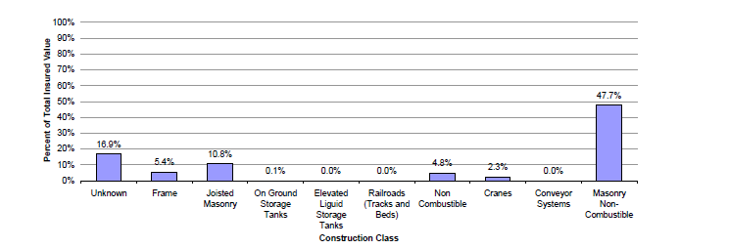
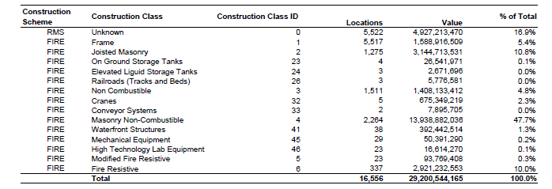
EXPOSURE BY CONSTRUCTION CLASS
62.50%

Slide 21
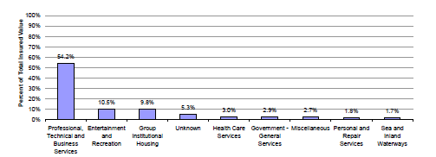
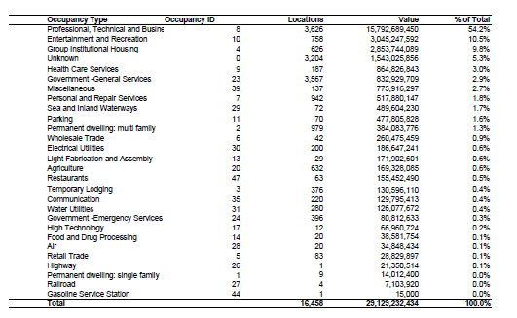
EXPOSURE BY OCCUPANCY TYPE

Slide 22
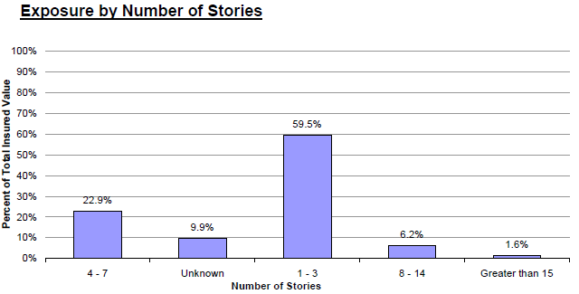
EXPOSURE BY NUMBER OF STORIES

Slide 23
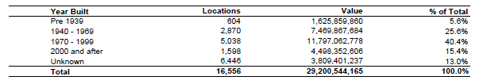
EXPOSURE BY YEAR BUILT

Slide 24
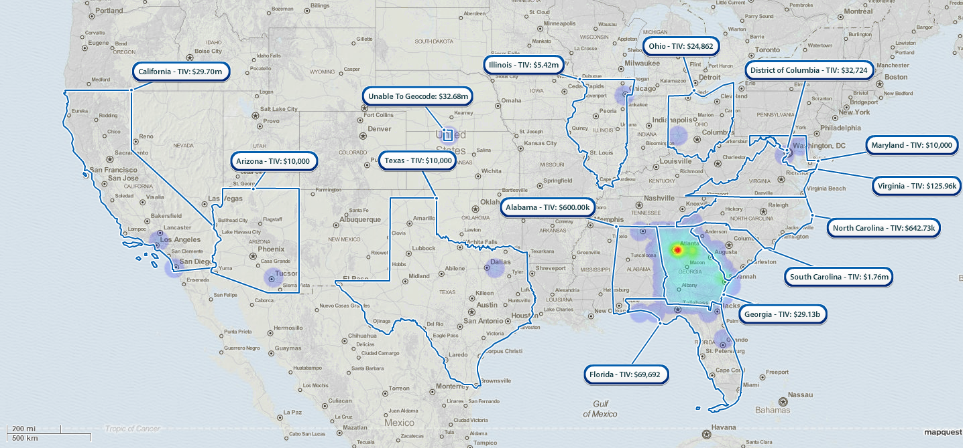
TIV BY STATE

Slide 25
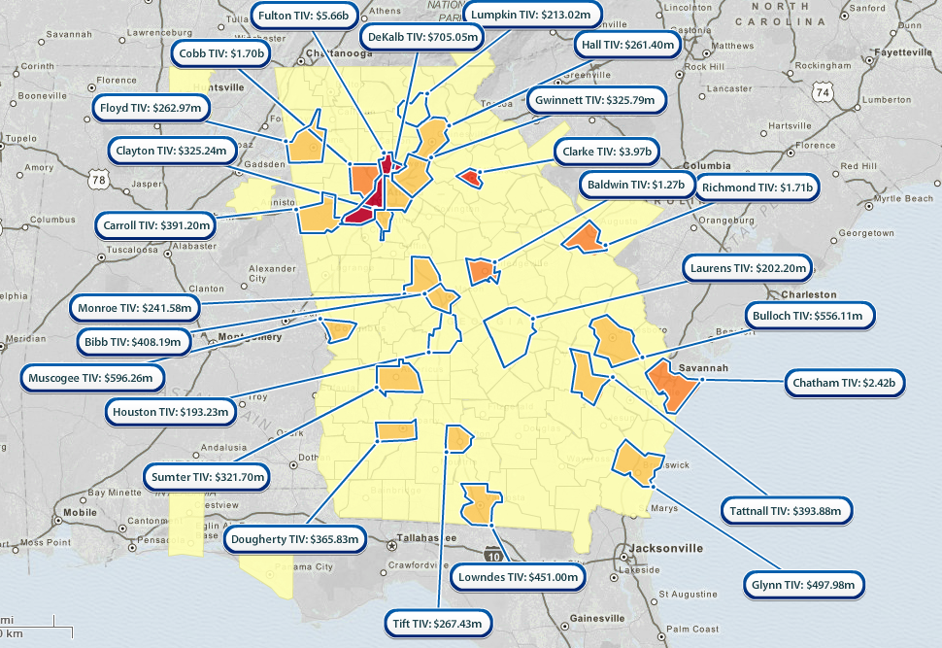
TIV BY COUNTY

Slide 26
GEOCODING RESULTS
Data | Analyzed | Comments
Number of Locations | 16,156
Aggregate Values | $32,409,973,950
Coverage Types | Building, contents, business interruption | Building coverage is approximately 80% of the total exposure.
Geocoding Results | 16,156 | Approximately 77% of the locations TIV in the portfolio are geocoded to high street or coordinate level resolution. A high level of geocoding is considered excellent, as high resolution geocoding reduces uncertainty in loss estimates.
Construction Scheme | ISO-Fire | Approximately 47% of the total exposure is classified primarily as 'Masonry Non-Combustible' as their construction class.
Occupancy Scheme | ATC | Approximately 56% of the total exposure is classified as 'Professional Technical' as their occupancy.
Number of Stories | Yes | Number of stories is known for 88% of the locations in the portfolio.
Year of Construction | Yes | Year built is known for 88% of the locations in the portfolio.

Slide 27
VALUE DISTRIBUTION
Summary of TIV by Unit of Insurance
Unit of Insurance | Previous FY14 | Expiring FY15 | Renewal FY16
Building | $22,570,405,069 | $24,103,256,134 | $26,330,082,256
Contents | $5,649,711,597 | $5,489,894,228 | $5,182,963,785
Total Property Coverage | $28,220,011,666 | $29,593,150,362 | $31,513,019,349
Business Interruption | $850,933,902.00 | $866,794,706 | $896,954,602
Grand Total | $29,071,050,568 | $30,459,945,068 | $32,409,973,951

Slide 28
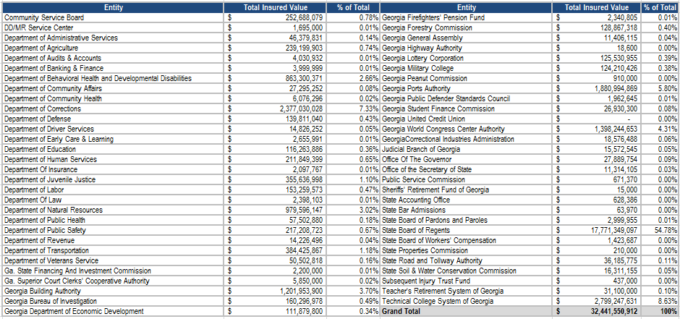
VALUES BY AGENCY

Slide 29
BLLIP RMS TAB
RMS Information
Consolidated Customer ID: | 99900000
Consolidated Customer Location: | 001
Insured Building Value: | $787,057
Insured Contents Value: | $510,000
CSB/DD MR Service Center? | No
Last Updated (RMS): | Jun 29, 2015
Data Status (RMS): | Needs Review

Slide 30
STATE OWNED BUILDING & PERSONAL PROPERTY
Coverage
  DOAS will pay for direct physical loss, damage or destruction to Covered Property at the premises/location reported and described “BLLIP” caused by or resulting from a Covered Cause of Loss.
  Covered Property
    Covered Property as used in this Agreement means the following types of property reported to Risk Management Services and described in “BLLIP” and for which a location and value is shown.

Slide 31

FISCAL YEAR 15
    New Claims 269
    $9.3M
    (Includes a 5.2 M GPA Fire payment for FY15)

Slide 32
BLLIP / PROPERTY COVERAGE CONNECTION
DOAS BLLIP GOALS FOR FY17
  IMPROVE THE QUALITY OF THE BLLIP DATA
  WORK WITH SPC TO ENHANCE AGENCIES ABILITY TO UPLOAD DATA
  BROADEN COMMUNICATION ON THE IMPORTANCE OF COMPLETING MISSING BLLIP DATA FIELDS
  EXPAND COVERAGE RENEWAL PERIOD FROM OCTOBER 1st THRU FEBRUARY 1ST

Slide 33
Contact Information
    Risk Management Services
    200 Piedmont Ave, SE, Suite 1208 West
    Atlanta, GA 30334
    Wade Damron, Director
    Wade Damron@doas.ga.gov, 404-463-7982
    Frederick Trotter, Property Program Officer
    Frederick.Trotter@doas.ga.gov, 404-463-2143
    Martha Williams, WC Program Officer
    Martha.Williams@doas.ga.gov, 404-463-1499
    Mark McKinney, Liability Program Officer
    Mark.McKinney@doas.ga.gov, 404-656-4817
    C.G. Lawrence, Safety and Loss Control Officer
    Charles.Lawrence@doas.ga.gov, 404-657-4457
    Hiram Lagroon, Safety and Loss Control Officer
    Hiram. Lagroon@doas.ga.gov, -404-6536309
Website: www.doas.ga.gov

Slide 34

Questions & Answers

Slide 35
404.656.6245
www.DOAS.ga.gov

Slide 36
State Properties Commission
Real Property Portfolio Management
Transaction Management
Methods to Reduce Your Lease Cost- Tamika Crittenden

Slide 37
State Properties Commission
Real Property Portfolio Management
Transaction Management - Methods to Reduce Your Lease Cost
The Four M’s
Market
Measure
Move
Multi-year Lease

Slide 38
State Properties Commission
Real Property Portfolio Management
Transaction Management - Methods to Reduce Your Lease Cost
Market & Move – Agency A (Savannah)

Slide 39
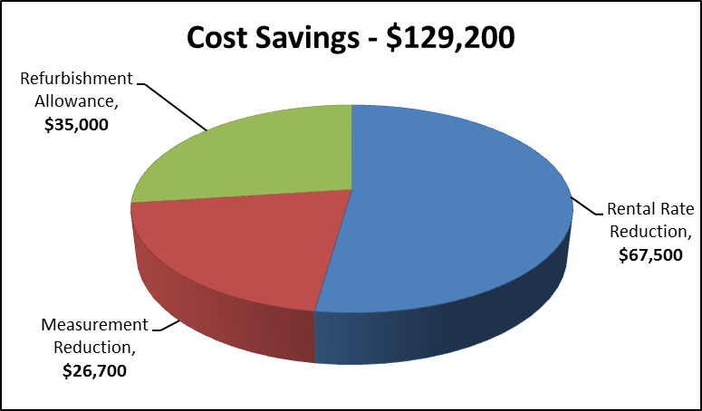
State Properties Commission
Real Property Portfolio Management
Transaction Management - Methods to Reduce Your Lease Cost
Measure & Multi-year Lease – Agency B (Atlanta)

Slide 40
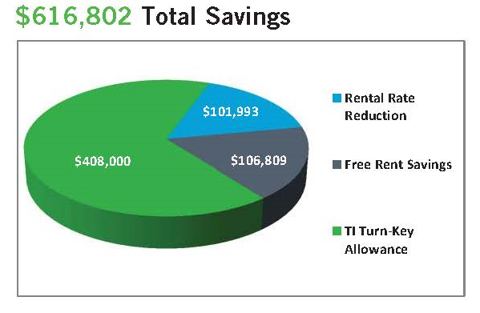
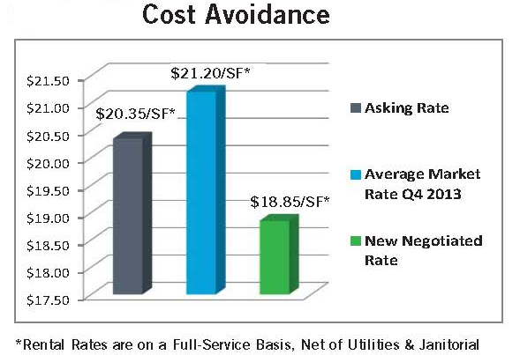
State Properties Commission
Real Property Portfolio Management
Transaction Management - Methods to Reduce Your Lease Cost
Move and Multi-year Lease – Agency C (Cumming)

Slide 41
State Properties Commission
Real Property Portfolio Management
Transaction Management - Methods to Reduce Your Lease Cost
The Four M’s
Market – Know It
Measure – Check It
Move – Say It…When you Mean It
Multi-year Lease – Offer It

Slide 42
State Properties Commission
Real Property Portfolio Management
Land Acquisition and Disposition Management
Policy Updates: SPC Streamline Disposition Process- J. Wade

Slide 43

Disposition Process
State Properties Commission
Real Property Portfolio Management
For questions or additional information, contact
Ryan Remle – Phone: (404) 232-1255 – Email: ryan.remle@spc.ga.gov
Clark Wong – Phone: (404) 656-2360 – Email: clark.wong@spc.ga.gov
J. Wade – Phone: (404) 463-6161 – Email: j.wade@spc.ga.gov

Slide 44
State Properties Commission
Real Property Portfolio Management
Introduction
2014 Resolution Act 580 (House Bill No. 495):
Conveyance of state property without prior General Assembly authorization.
2015 Resolution Act No. 112 (House Bill No. 104):
Removed Easements, Revocable License Agreement, Exchanges, and Long-term Lease from requirement of competitive bid.

Slide 45
State Properties Commission
Real Property Portfolio Management
Purpose of Acts
To expedite and facilitate state property conveyances [sales, long-term leases (leases over 3 years), and easements], especially when General Assembly is not in session.

Slide 46
State Properties Commission
Real Property Portfolio Management
Non-qualified Properties
The following conveyances require legislative authorization:
Surplus properties including exchanges with a value of more than $500,000.
Easements exceeding a value of $500,000.
Any long-term leases exceeding value of $500,000.
Any proposed conveyance that was not in an expedited process can be included in legislation during a regular session.

Slide 47
State Properties Commission
Real Property Portfolio Management
Qualified Properties
The following conveyances do not require prior legislative authorization:
Surplus properties including exchanges with a value of $500,000 or less
Easements with a value of $500,000 or less
Long-term ground leases with a value of $500,000 or less
But these conveyances do require a 30-day notice of intent to convey to certain General Assembly members and Legislative Counsel.

Slide 48
State Properties Commission
Real Property Portfolio Management
Expedited Conveyance Process
Determine value of conveyances (Easements, Long-term Leases from State, Fee Simple):
SPC will obtain an opinion of value or an appraisal for surplus property, easement, or lease.
Conveyance to Public Entity – Opinion of value needed.
Conveyance to Private Entity – Appraisal needed. If value exceeds $100,000, a second appraisal is required.

Slide 49
State Properties Commission
Real Property Portfolio Management
Expedited Conveyance Process Cont’d
If a fee simple conveyance: agency will initially pay for surveys, and opinions of value or appraisals, and will be reimbursed at closing. New survey is not required if selling entire property previously surveyed. For properties over 5 acres, the agency will at a minimum pay for a GEPA environmental checklist, and be reimbursed at closing.

Slide 50
State Properties Commission
Real Property Portfolio Management
Expedited Conveyance Process Cont’d
For easements that do not benefit the state and long-term leases not for a public purpose: opinion of value or appraisals will be engaged by SPC and paid by Grantee; and surveys will be to state standards, approved by SPC, and paid by Grantee.
For easements that benefit the state and long-term leases for public purpose: the agency may be required to pay for survey or opinion of value or appraisal.

Slide 51
State Properties Commission
Real Property Portfolio Management
Invitation To Bid (ITB)
Private Entities interested in either purchasing fee simple or leasing surplus State-owned property (qualified and non-qualified) go through a competitive sealed bid process generated by a public notice known as an “Invitation To Bid” (ITB).
The State Property Officer can reject any bid that is less than the minimum bid or 75% of the appraised value. Only the most advantageous bid will be accepted.

Slide 52
State Properties Commission
Real Property Portfolio Management
Invitation To Bid (ITB) Cont’d
Best and Final Offer Process may be utilized when multiple bids are received that meet or exceed the minimum bid or at the discretion of the SPC Executive Director.
Prior to issuance of an ITB, a Marketing Package will be created by SPC to raise awareness of a surplus property.

Slide 53

State Properties Commission
Real Property Portfolio Management
Marketing Package

Slide 54
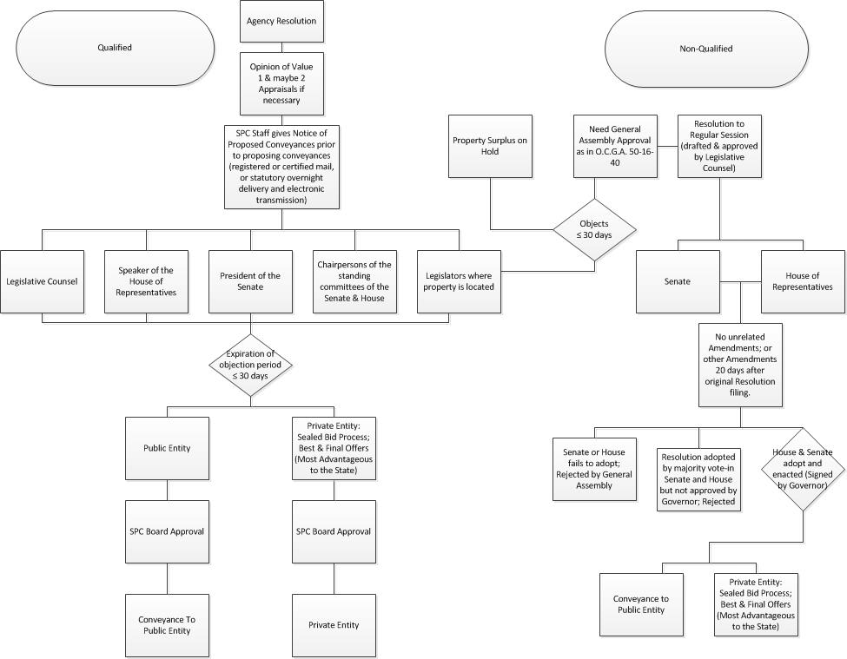
State Properties Commission
Real Property Portfolio Management
Flow Chart of Process

Slide 55
Contact Information
State Properties Commission
Frank Smith- Deputy Executive Director
Office: (404) 656-5602
Alisa Pereira- Assistant Director
Office: (404) 463-5861
J. Wade- Land Acquisition & Disposition Manager
Office: (404) 463-6161
Tamika Crittenden- Leasing Section Manager
Office: (404) 463-5570
Andre’ Elam- Business Asset Analyst
Office: (404) 463-6443
Note: A copy of this REMAT Presentation can be obtained at http://gspc.georgia.gov/publications
www.spc.georgia.gov

Slide 56
State Properties Commission
Real Property Portfolio Management

