Slide 1

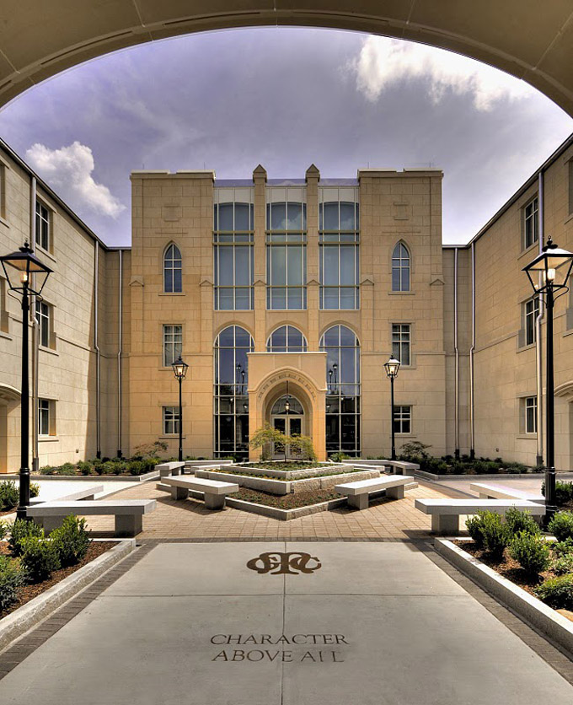

State Properties Commission
Real Property Portfolio Management
Mission:
To advise, guide and maximize Georgia’s real estate portfolio by applying industry best practices in asset, space and transaction management
LEASING  SPACE PLANNING/DESIGN  ASSET MANAGEMENT  LAND ACQUISITIONS & DISPOSITIONS

Slide 2
State Properties Commission
Real Property Portfolio Management
Agenda
Welcome- Alisa Pereira, Assistant Director
Transaction Management Remarks
    State Fire Marshal Office Requirements for State Owned and Occupied Spaces- Jeff Mayers
Space Management Remarks
    New Space Standards- Alisa Pereira
Land Acquisition & Disposition Remarks
    Year-End Deadlines
Asset and Portfolio
    Property Renewal Review and ISO Building Classifications- Frederick Trotter
Q & A

Slide 3
State Properties Commission
Real Property Portfolio Management
Transaction Management
    State Fire Marshal’s Office Requirements for State Owned
    and Occupied Spaces
    -Jeff Mayers

Slide 4
State Properties Commission
Real Property Portfolio Management
Space Management
Revised Space Standards and Tolerance Tables
- Alisa Pereira

Slide 5
State Properties Commission
Real Property Portfolio Management
OFFICE SPACE STANDARDS
Title / Function | Type | Allocated SF
Executive Director, Commissioner, Agency Head | Office | 220
Deputy Executive Director, Deputy Commissioner, Division Director, Regional Director, Local Manager | Office | 120
Manager, Supervisor, Coordinator (5 or more direct reports) | Workstation | 64 (8 x 8)
Professional Staff, Administrative, Tech | Workstation | 49 (7x7)
Hoteling / Call Center | Workstation | 20 (5x4)

Slide 6
State Properties Commission
Real Property Portfolio Management
CONFERENCE SPACE STANDARDS
Type | Number of Occupants | Square footage | Typical Tech Equipment
HUDDLE ROOM | 1 – 3 | 100 | Speaker phone
SMALL CONFERENCE ROOM | 6 – 8 | 275 | Speaker phone; flat screen or overhead projector with screen; data connectivity at table;
MEDIUM CONFERENCE ROOM or PROJECT / TEAM ROOM | 10 – 12 | 350 | Speaker phone; flat screen or overhead projector with screen; data connectivity at table; option of video conferencing
LARGE CONFERENCE ROOM Multi-Purpose Room with configurable tables | 14 – 16 | 500 | Speaker phone; flat screen or overhead projector with screen; data connectivity at table; option of video conferencing and distributed speakers
TRAINING / SEMINAR ROOM Multi-Purpose Room(s) | 24 – 32 | 1,000 | Speaker phone; flat screen or overhead projector with screen; data connectivity at table; option of video conferencing, distributed speakers and multiple screens and projectors and distributed power access and speakers.
 | 41 - 60 | 2,000

Slide 7
State Properties Commission
Real Property Portfolio Management
Square footage is greater than SPC program
Square Footage | Tolerance Allowed
0 – 2,500 | 30%
2,501 - 10,000 | 20%
10,001 - Above | 10%
Square footage is less than SPC program
Square Footage | Tolerance Allowed
0-10,000 | No deviation allowed
10,001- Above | 3%
Note: A copy of the revised Space Standards and Tolerance Tables can be obtained at http://gspc.georgia.gov/space-management

Slide 8
State Properties Commission
Real Property Portfolio Management
Land Acquisition & Disposition Management
Year-End Deadlines- J. Wade
Legislative Deadlines
SAAG Hires and Closings
SPC Board Meeting

Slide 9
SPC Land
State Properties Commission
Real Property Portfolio Management
J. Wade
Clark Wong
Ryan Remle

Slide 10

Legislative Deadlines
State Properties Commission
Real Property Portfolio Management

Slide 11
Legislative Deadlines
State Properties Commission
Real Property Portfolio Management
December 1: 2016 Legislation Requests submitted to SPC for fee simple conveyances, easements or long-term leases;
December 15: Complete Legislation files must be submitted to SPC electronically and hard copies.

Slide 12

SAAG Hires & Closings
State Properties Commission
Real Property Portfolio Management

Slide 13
SAAG Hires & Closings
State Properties Commission
Real Property Portfolio Management
November 18: Early SAAG hire requests to SPC
December 18: All 2015 Acquisitions will be closed on or before this date.

Slide 14

SPC Board Meeting
State Properties Commission
Real Property Portfolio Management

Slide 15
SPC Board Meeting
State Properties Commission
Real Property Portfolio Management
December SPC Board Meeting requested for the week of December 15, 2015
November 19: Requests for items to be included in December meeting need to be sent to SPC.
November 24: All print and electronic files must be received by SPC for December board meeting.

Slide 16
Thank You!
State Properties Commission
Real Property Portfolio Management

Slide 17
State Properties Commission
Real Property Portfolio Management
Asset and Portfolio Management
    Property Renewal Review and ISO Building Classifications
    - Frederick Trotter

Slide 18
SPC REMAT PROPERTY DISCUSSION
PROPERTY PROGRAM
FREDERICK TROTTER

Slide 19
FY17 Renewal Review
What is COPE Data and why is it important?
Determining Replacement Cost
(square footage calculation x price per sq. ft.)
Building Classifications (ISO)
Occupancy Type x Building Construction

Slide 20
COPE DATA
Construction: frame, brick, masonry veneer, etc
Occupancy: how is the building being used
Protection: quality of fire protection system, sprinkler system, smoke detectors adequacy of water pressure, water supply in the community
Exposure: risk of loss posed by neighboring property or surrounding area, located in a flood zone, near a lake, dam or coastal.

Slide 21
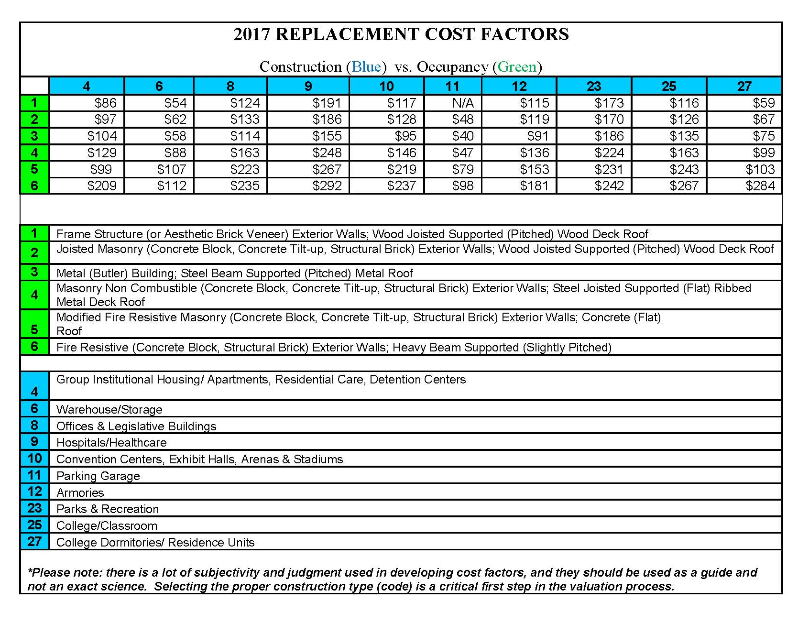

Slide 22
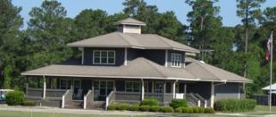
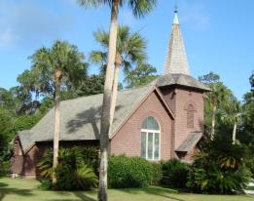

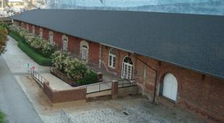

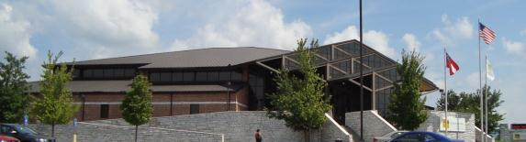
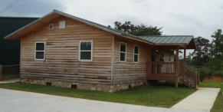
Insurance Service Office (ISO)
Building Classifications

Slide 23
ISO Building Classifications
Building Construction has been used as part of the
insurance rating factor for over 100 years.
ISO has developed a system of classification for buildings.
This system is made up of six categories:
Class 1 – Frame
Class 2 – Joisted Masonry
Class 3 – Non-combustible
Class 4 – Masonry Non-combustible
Class 5 – Modified Fire Resistive
Class 6 – Fire Resistive

Slide 24
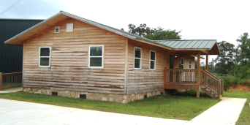
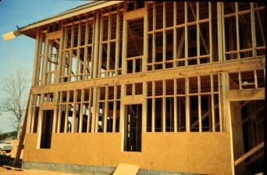
Frame Construction
Buildings with exterior walls, floors, & roofs of combustible construction; or buildings with exterior walls of non-combustible or slow-burning construction with combustible floors and roofs.
Frame buildings generally have roofs, floors, and supports of combustible material; usually wood, and combustible interior walls.

Slide 25
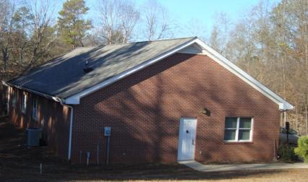
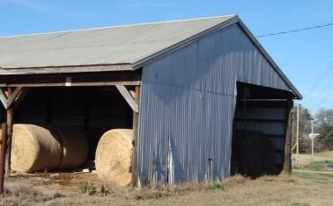
FRAME CONSTRUCTION – Exterior coatings do not change the construction class (for example: brick veneer, metal clad).
Building is being held up
by 2” x 4” wood studs,
wood roof and wood floors.
Brick Veneer is a siding that
does not provide any
structural support.
Building being held up
by wood frame.
Metal siding does
provide structural support.

Slide 26
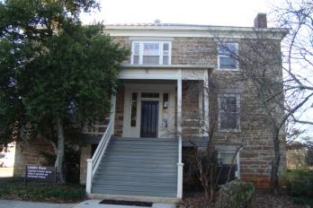
Joisted Masonry
Buildings with exterior walls of masonry or fire-resistive material
(e.g.: adobe, brick, concrete, gypsum block, hollow concrete block, stone, tile, or similar materials) rated for not less than 1 hour and with combustible floors and roofs.

Slide 27
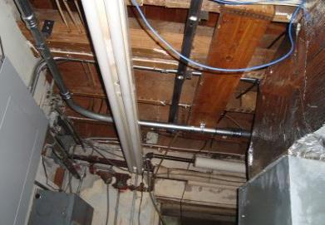
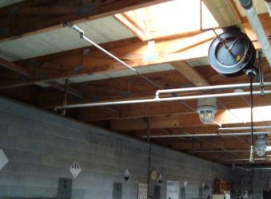
Joisted Masonry
Wood joisted floors
supported by masonry walls
Wood joisted roof
supported by masonry
(cinder block) walls

Slide 28
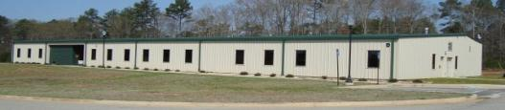
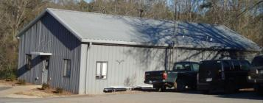
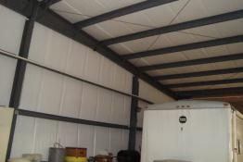
Non-Combustible
Buildings with exterior walls, floors, and roofs of noncombustible or slow-burning materials;
Building supports of non-combustible or slow-burning materials;
Non-combustible or slow-burning roof decks on non-combustible or slow-burning supports regardless of the type of insulation on the roof surface.

Slide 29
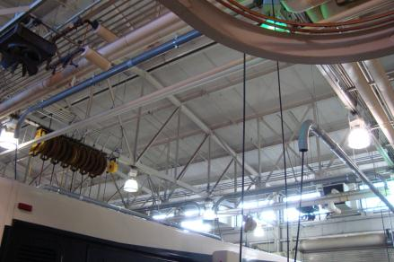
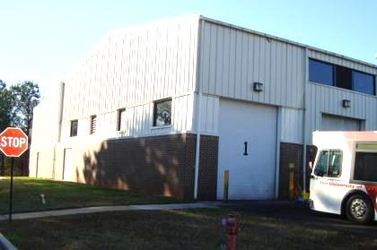
Non-Combustible
Building roof
supported by
metal trusses.
Building Class does not
change because of
exterior covering.

Slide 30
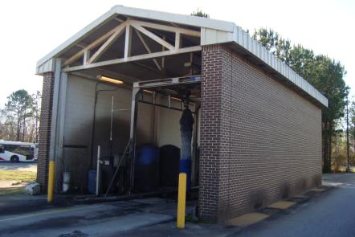
Masonry Non-Combustible
Buildings with exterior walls of masonry — not less than four inches thick; or
Buildings with exterior walls of fire-resistive construction — with a rating of not less than one hour, and
Non-combustible or slow-burning floors and roofs — regardless of the type of insulation on the roof surface.

Slide 31
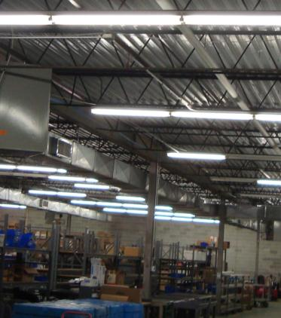
Masonry Non-Combustible
Metal roof support and
metal roof in this case,
with masonry walls.
Masonry walls.

Slide 32
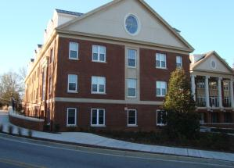
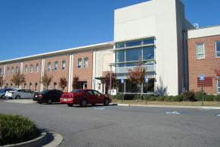
Modified Fire Resistive
Buildings with exterior walls, floors, and roofs of masonry materials between four and eight inches thick; or
Fire-resistive materials with a fire-resistance rating less than two hours but not less than one hour.
The exterior bearing walls and load-bearing portions of the exterior walls must be of non-combustible materials or of masonry, but exterior nonbearing walls and wall panels may be slow-burning, combustible, or with no fire-resistance rating..

Slide 33
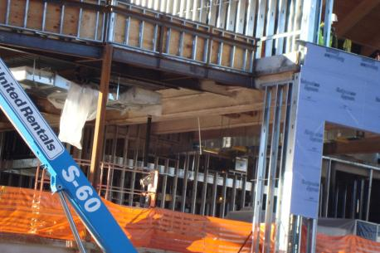
Modified Fire Resistive
Building is supported
by steel frame.
To get Modified
Fire Resistive class
metal frame must
be protected.

Slide 34
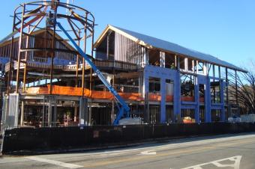
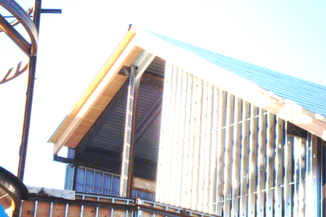
Modified Fire Resistive
Building is supported
by steel frame.
Walls will be covered
with brick veneer.
This will not change the
building classification.
Building has a
metal frame roof.
The wood trim
does not provide
structural support.

Slide 35
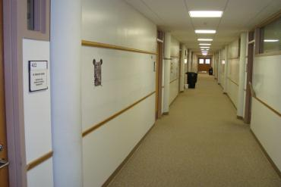
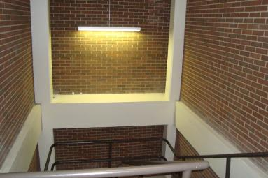
Masonry supports
Fire Resistive
Walls
Solid masonry, including reinforced concrete not less than four inches thick;
Hollow masonry not less than 12 inches thick;
Hollow masonry less than 12 inches thick, but not less than eight inches thick with a listed fire-resistance rating of not less than two hours.
Masonry supports

Slide 36
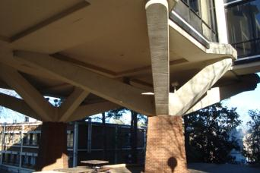
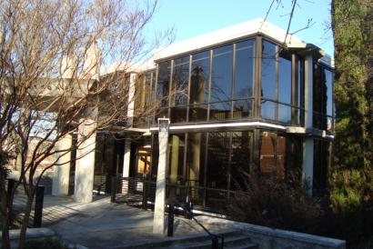
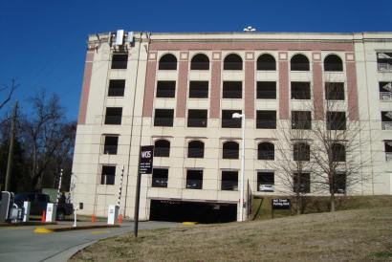
Fire Resistive (cont’d)
The exterior bearing walls and load-bearing portions of exterior walls must be of non-combustible materials or of masonry; but exterior nonbearing walls and wall panels may be slow burning, combustible, or with no fire-resistance rating.
l

Slide 37
Contact Information
    Wade Damron, Director
    Wade Damron@doas.ga.gov, 404-463-7982
    Frederick Trotter, Property Program Officer
    Frederick.Trotter@doas.ga.gov, 404-463-2143
    Martha Williams, WC Program Officer
    Martha.Williams@doas.ga.gov, 404-463-1499
    Mark McKinney, Liability Program Officer
    Mark.McKinney@doas.ga.gov, 404-656-4817
    C.G. Lawrence, Safety and Loss Control Officer
    Charles.Lawrence@doas.ga.gov, 404-657-4457
    Hiram Lagroon, Safety and Loss Control Officer
    Hiram. Lagroon@doas.ga.gov, -404-6536309
    Risk Management Services
    200 Piedmont Ave, SE, Suite 1208 West
    Atlanta, GA 30334
    Website: www.doas.ga.gov

Slide 38


Slide 39
Contact Information
State Properties Commission
Real Property Portfolio Management
Frank Smith- Deputy Executive Director
Office: (404) 656-5602
Alisa Pereira- Assistant Director
Office: (404) 463-5861
J. Wade- Land Acquisition & Disposition Manager
Office: (404) 463-6161
Tamika Crittenden- Leasing Section Manager
Office: (404) 463-5570
Andre’ Elam- Business Asset Analyst
Office: (404) 463-6443
Note: A copy of this REMAT Presentation can be obtained at http://gspc.georgia.gov/publications

