Slide 1
Real Estate Management Advisory Team Meeting
January 28, 2025
LEASING  SPACE PLANNING/DESIGN  ASSET/PROJECT MANAGEMENT  LAND ACQUISITIONS & DISPOSITIONS

Slide 2
8:30 Coffee and Networking
9:00 Introduction of the State Properties Commission Team:
Frank Smith, Deputy Executive Director, SPC
Terry Jones, Assistant Director, SPC
9:15 Welcome:
Colonel William W. Hitchens, Commissioner, DPS
9:30 Overview of Real Estate Markets and Trends:
Erik Weiss, Savills, Vice Chairman
Kari Downing, Savills, Managing Director
Ally Juratovac, Savills, Research Associate
Raquel Howard, Savills, Assistant Director
Devon Munos, Savills, Vice President, Research Strategy & Insights
Mike Griffin, Savills, Vice Chairman, Florida Region
10:00 Break and Networking
10:15 Risk Management Services:
Wade Damron, Director of Risk Management Services, DOAS
10:30 Housekeeping:
Renewal Reports and Leasing Packages
Facility Inspection Checklists
Upcoming Renegotiations
Agenda
LEASING  SPACE PLANNING/DESIGN  ASSET/PROJECT MANAGEMENT  LAND ACQUISITIONS & DISPOSITIONS

Slide 3
11:00 Doing Business with SPC (Renew, Renegotiate, Relocate)
Space Management - Ginette Tatem, Inventory Analyst, SPC
Tim Barker, Space Designer, SPC
Leasing - Terry Jones, Assistant Director, SPC
Project Management -David Allen, Asset Manager, SPC
11:45 Visual History of DPS:
Lanie Weathers, Project Coordinator, DPS
12:00 Break and Networking
12:15 Lunch Presentation Speaker:
Dr. William Smith, Ph.D., Chair of the Department of Economics,
University of West Georgia
1:00 Closing Remarks:
Frank Smith, Deputy Executive Director, SPC
Terry Jones, Assistant Director, SPC
Agenda
LEASING  SPACE PLANNING/DESIGN  ASSET/PROJECT MANAGEMENT  LAND ACQUISITIONS & DISPOSITIONS

Slide 4
Sample Renewal Report
LEASING  SPACE PLANNING/DESIGN  ASSET/PROJECT MANAGEMENT  LAND ACQUISITIONS & DISPOSITIONS

Slide 5
Maintenance & Improvements
Tenant Improvements
Deferred Maintenance
LEASING  SPACE PLANNING/DESIGN  ASSET/PROJECT MANAGEMENT  LAND ACQUISITIONS & DISPOSITIONS

Slide 6
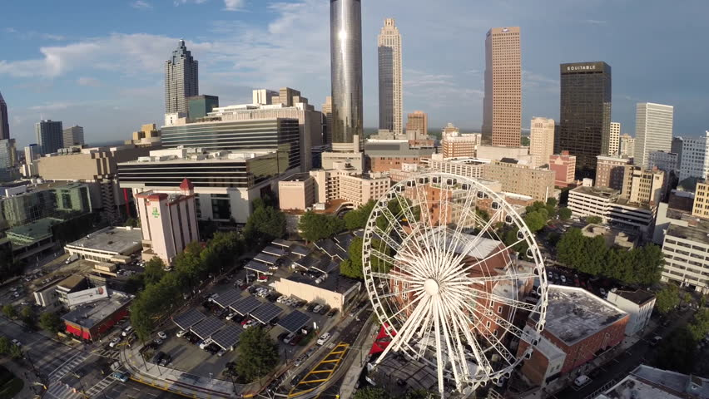
Renegotiation
Renegotiation Report sent out in October 2024
Tenant-at-Will
LEASING  SPACE PLANNING/DESIGN  ASSET/PROJECT MANAGEMENT  LAND ACQUISITIONS & DISPOSITIONS

Slide 7
STATE PROPERTIES COMMISSION
SPACE MANAGEMENT OVERVIEW

Slide 8
SPACE ACTION FORM (SAF)
The Space Action form initiates the formal request to SPC to perform an action on behalf of the occupying agency. The form is used for the following request types:
Renegotiations
Cancellations
Other (New, Relocations, Expansions, Co-locations, Amendments, Landlord Issues, Address Change, and Facility Issues.
Note: All new requests, relocations, expansions, and co-locations please complete the following for submission to Space Management.
Space Action Form (SAF)
Space Utilization Questionnaire (SUQ)
Organizational Chart specific to that requested location
Agency Design Specifications (if applicable)

Slide 9
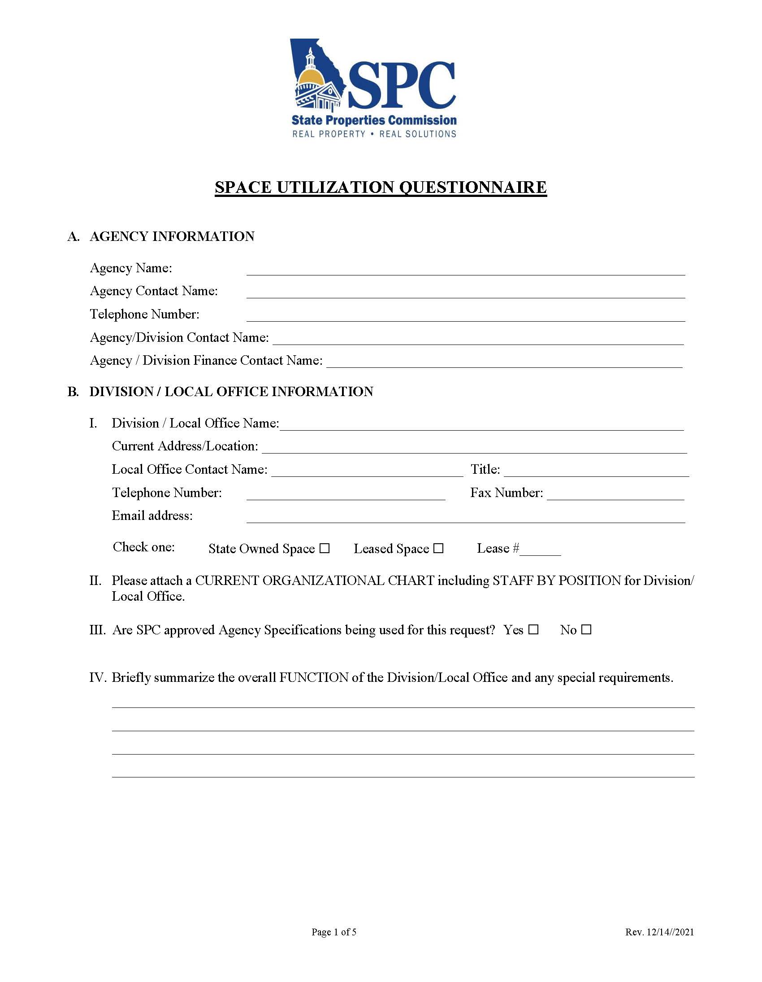
Space Utilization questionnaire (SUQ)

Slide 10
Space Utilization questionnaire (SUQ)

Slide 11
Space Utilization questionnaire (SUQ)

Slide 12
If you have any questions, contact us:
Terry Jones
Terry.Jones@spc.ga.gov
Ginette Tatem
Ginette.Tatem@spc.ga.gov
Timothy Barker
Tim.barker@spc.ga.gov

Slide 13
Leasing
Annual & Short-term Agreements
Multi-year Rental Agreements
Long-Term Agreements
LEASING  SPACE PLANNING/DESIGN  ASSET/PROJECT MANAGEMENT  LAND ACQUISITIONS & DISPOSITIONS

Slide 14
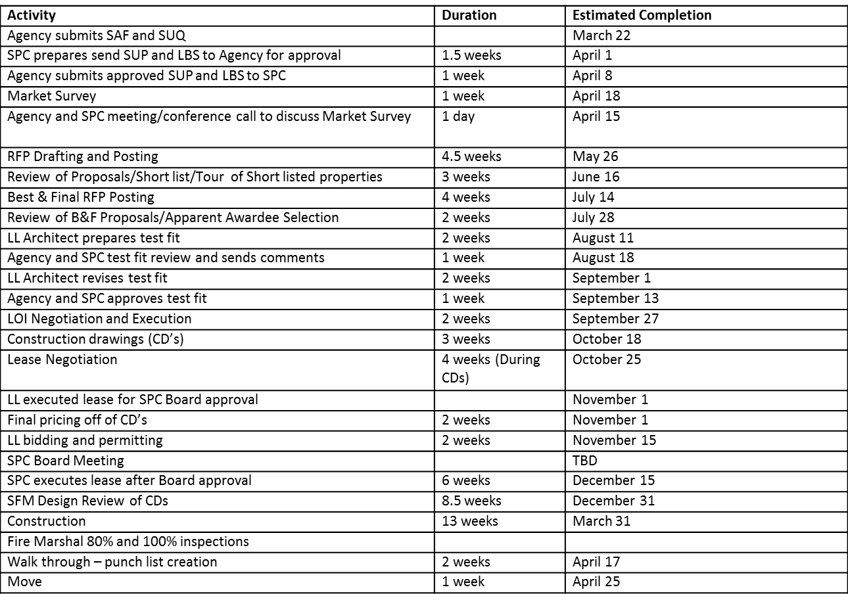
Lease Relocation Schedule Example
www.spc.georgia.gov

Slide 15
David Allen – Space Quality Management Marquach’e Medina – Project Manager
Project Management Fundamentals
LEASING  SPACE PLANNING/DESIGN  ASSET/PROJECT MANAGEMENT  LAND ACQUISITIONS & DISPOSITIONS

Slide 16
Agenda
1. What is project management?
2. The role of project management
3. Space Quality Management
4. Summary and key takeaways
5. FAQ/Q&A
LEASING  SPACE PLANNING/DESIGN  ASSET/PROJECT MANAGEMENT  LAND ACQUISITIONS & DISPOSITIONS

Slide 17
Definition of project management
“The application of knowledge, skills, tools and techniques to project activities to meet project objectives.”
Role of project management:
Project Management will ensure projects meet deadlines.
Stay within budget.
Adhere to quality standards and specifications.
LEASING  SPACE PLANNING/DESIGN  ASSET/PROJECT MANAGEMENT  LAND ACQUISITIONS & DISPOSITIONS

Slide 18
Responsibilities of a Project Manager
Planning and organizing
Directing communication with stakeholders
Managing risk
LEASING  SPACE PLANNING/DESIGN  ASSET/PROJECT MANAGEMENT  LAND ACQUISITIONS & DISPOSITIONS

Slide 19
Summary and Key Takeaways
Recap of essential points:
Project Management ensures goals are met efficiently.
Good communication and adaptability are vital.
Complete a Facility Inspection Checklist.
FIC
Click Icon
Questions??
LEASING  SPACE PLANNING/DESIGN  ASSET/PROJECT MANAGEMENT  LAND ACQUISITIONS & DISPOSITIONS

